Slide 1
Transition Plan is Not Just a Form: Transition to Adulthood
Institute on Disabilities at Temple University
Families Reimaging Inclusive Lives (FRIL)

Slide 2
Institute on Disabilities at Temple University Pennsylvania’s University Center for Excellence in Developmental Disabilities Education, Research and Service
hi
VISION
A society where all people are valued and respected, and where all people have the knowledge, opportunity and power to improve their lives and the lives of others.
MISSION The Institute on Disabilities at Temple University learns from and works with people with disabilities and their families in diverse communities across Pennsylvania to create and share knowledge, change systems, and promote self-determined lives so that disability is recognized as a natural part of the human experience.

Slide 3
Families Reimaging Inclusive Lives (FRIL) project is funded by the Pennsylvania Developmental Disabilities Council (PADDC).

Slide 4
Objectives
Understand the importance of having a vision to guide transition planning
Be able to describe the areas to consider when transition planning
Understanding your rights and responsibilities
Gather resources to support successful transition

Slide 5
Transition includes...
early intervention to kindergarten
elementary school to middle school
middle school to high school
and finally... high school to adulthood (employment or post-secondary opportunities)
Notes:
Intro to transition planning

Slide 6
WHAT IS TRANSITION PLANNING?
Transition planning is a process that helps students with disabilities prepare for life after high school.

Slide 7
Video: What is Transition Planning?
Notes:
Source:
https://youtu.be/XcIT29_xOd0
Transition Discoveries- Transition Planning
Video 2:31minutes

Slide 8
Pillars of Transition Planning in the IEP
Outcome oriented
Strength oriented
A coordinated effort between families, teachers and outside agencies
Notes:
Added from Transition Coalition module "Best Practices in Transition"

Slide 9
Requirements for Transition in the IEP
In Pennsylvania, when a student turns 14, the IEP must include a transition plan
Schools required to invite students to their IEP meetings whenever transition is discussed
Updated every year, or more as needed
Includes preparation for life after high school in the areas of employment, postsecondary education and training, and independent living
Notes:
Info from DRP and Transition Coalition https://www.health.pa.gov/topics/school/Pages/Transition.aspx
The Individuals with Disabilities Education Act (IDEA) and Pennsylvania’s Special Education Law, sometimes referred to as “Chapter 14”, require public schools to help students with disabilities succeed while in school and prepare them for life after graduation.

Slide 10
Having a Vision for Transition-Components of a Transition Plan
Based on student's strengths, preferences, and interests
Transition assessments
Measurable post-secondary goals
Post-school outcomes
Transition services

Slide 11
Transition in the EIP
IEP Team identifies present levels of strengths, needs, interests
IEP: Measurable post-secondary goals
Transition services
Annual goals • Course of study • Other activities
Notes:
Info from DRP and Transition Coalition https://www.health.pa.gov/topics/school/Pages/Transition.aspx
The Individuals with Disabilities Education Act (IDEA) and Pennsylvania’s Special Education Law, sometimes referred to as “Chapter 14”, require public schools to help students with disabilities succeed while in school and prepare them for life after graduation.

Slide 12
Student's Strengths, Preferences and Interests
Crucial for student success
Allows for personalized plan that maximizes potential
Empowers them to take active role in decisions about their future
Plan can be designed with relevant goals
Utilize a strengths-based approach promotes self-esteem
Identifies challenges and possible barriers

Slide 13
Transition Assessments
Required by law to determine transition goals and services
Areas: training, education, employment and independent living skills
Results documented in Present levels of academic achievement and functional performance section of the IEP
Examples
Interviews
Online assessments
Surveys
Interest inventories

Slide 14
Setting Goals: Education
Post-School Outcomes
Measurable Post-Secondary Goals
After graduation, Sarah will enroll in a culinary arts program at a community college.
When given a 10-ingredient recipe, Sarah will correctly measure all ingredients in 8 out of 10 trials.

Slide 15
Setting Goals: Employment
Post-School Outcomes
Measurable Post-Secondary Goals
Craig will work part-time in a local bookstore with necessary supports.
Craig will be able to describe his disability and list three accommodations that would help support him in his work.

Slide 16
Setting Goals: Independent Living
Post-School Outcomes
Measurable Post-Secondary Goals
Lisa will live independently in an apartment with a roommate.
Lisa will open a checking account and accurately track her income and expenditures over the course of one month.

Slide 17
Transition Services
How the student will meet their goals
Areas: Instruction, Related Services, Community Experiences, Employment and Daily Living Skills
Includes services from post-secondary education, vocational rehabilitation services, centers for independent living and vocation training
Who is responsible for each service?
Family, teachers, outside agency

Slide 18
Summary of Performance (SOP)
Summary of academic achievement, functional performance and recommendations for meeting goals
Created when student exits special education services
Provides recommendations for helping them achieve their postsecondary goals
Required by the Individuals with Disabilities Education Act (IDEA) for students who are no longer eligible for special education services

Slide 19
WHAT'S NEXT?
A guide to post-secondary options
Notes:
See PEAL Center Transition Tuesdays

Slide 20
Office of Vocational Rehabilitation (OVR) Services
OVR provides free services to help people with disabilities find, keep, or advance in their careers
Services include counseling, job coaching, job assessments, job training, job placement and more

Slide 21
Employment: Starting Early
Get support through your LEA representative and transition supports in school
High school students with disabilities should consider applying for vocational rehabilitation (VR) services through the Office of Vocational Rehabilitation (OVR) at least two years before graduation
Notes:
Local Education Agency (LEA) a member of an IEP team who is responsible for ensuring that students with disabilities receive the services they need

Slide 22
Individualized Plan for Employment (IPE)
The person's desired employment outcome
The services and service providers that will be used
The responsibilities of both the person and the agency
The costs of VR services
Measurable criteria for tracking progress
An IPE is a written document that outlines a person's vocational goals, and the services needed to achieve them.
It includes:

Slide 23
Competitive Integrated Employment (CIE)
Type of work that involves people with disabilities working in integrated settings with people without disabilities.
Competitive- Employees with disabilities receive similar pay and benefits to employees without disabilities who perform the same work.
Integrated- Employees with disabilities work with people without disabilities in a variety of settings, including with co-workers, customers, and suppliers.
Notes:
a key concept in vocational rehabilitation and other efforts to improve employment outcomes for people with disabilities. It can help people with disabilities engage with a broader community, build relationships, and develop social skills. It can also help break down social barriers and misconceptions, and promote a more inclusive community.

Slide 24
CIE: Common Misconceptions
You need a letter from OVR to state that you are not competitively employable to be eligible for subminimum wage
You cannot receive services from both OVR and a waiver
My waiver budget does not have enough funds to accommodate support employment services
Everyone under 25 needs to go through OVR to obtain employment
Notes:
Resourece: https://www.dhs.state.mn.us/main/idcplg?IdcService=GET_DYNAMIC_CONVERSION&RevisionSelectionMethod=LatestReleased&dDocName=dhs-292836

Slide 25
CIE: Overcoming Barriers
Fear of losing benefits
Fear of losing benefits
Physical
Assistive Technology
Physical
Assistive Technology
Suggestions-Use OVR services
Here's where your child can use all the advocacy skills they have been building
Notes:
Resourece: https://www.dhs.state.mn.us/main/idcplg?IdcService=GET_DYNAMIC_CONVERSION&RevisionSelectionMethod=LatestReleased&dDocName=dhs-292836

Slide 26
Education Programs
Four-year college
Transition and post-secondary programs for students with intellectual disabilities (TPSID)
thinkcollege.net/ to find more programs
Two-year college
Technical or vocational school

Slide 27
"Think Higher. Think College."
Notes:
Campaign video - 4 minutes

Slide 28
Paying for Education Programs
Federal aid: FAFSA
State aid: PA State Grant
Work-study
Aid from college/university
Private scholarships
Office of Vocational Rehabilitation (OVR)
Notes:
OVR: "If your IPE includes college as part of your goal, OVR may provide money toward tuition. If you have special circumstances, such as medical expenses, you can apply for a waiver to receive additional aid. Tuition assistance from OVR is meant as a last resort. You need to use the FAFSA to apply for aid from the federal and state governments first. " - DRP
Aid from college/university: contact Financial Aid office to see if there are separate scholarship applications to fill out
Private scholarships: some scholarships available specifically for people with disabilities, see resources for list

Slide 29
Reasonable Accommodations
Changes or adjustments that make it possible for you to be successful in school and access all the services and benefits other students get
Required by ADA and Section 504
Examples
Extra time on tests
Providing note-takers
Providing assistive technology for schoolwork
Contact the school's disability services office

Slide 30
Independent Living
Research shows more independent living
leads to better quality of life outcomes
(Burke et al., 2019)
ThePhoto by PhotoAuthor is licensed under CCYYSA.

Slide 31
Residence Types
Group homes
Lifesharing
Own home
Intermediate Care Facilities (ICF)

Slide 32
Office of Developmental Program (ODP): Services
ODP offers a variety of services to help people with developmental disabilities, autism, and intellectual disabilities live more independently in Pennsylvania.
Waivers
Home and Community-Based Services Waiver
Community Living Waiver
Supports and Services

Slide 33
Voting
Option to include voter registration in IEP goals
Every polling place in Pennsylvania must have at least one accessible voting system
First-time voter support
ThePhoto by PhotoAuthor is licensed under CCYYSA.
Notes:
When you vote in person, you have a right to ask for accessibility accommodations that make it easy for you to vote. The Americans with Disabilities Act (ADA) checklist on polling place accessibility has information about what you can ask for. Guardianship does not exclude you from voting.

Slide 34
Self-Directing Services
Services that provide support to the individual that helps them make their own decisions.
Resources that provide assistance, guidance, legal information etc. That inform the individual to best help them live a self-directed life.
These services can be provided by state and local nonprofits or waiver services.
Notes:
When you vote in person, you have a right to ask for accessibility accommodations that make it easy for you to vote. The Americans with Disabilities Act (ADA) checklist on polling place accessibility has information about what you can ask for. Guardianship does not exclude you from voting.

Slide 35
Advocacy
Getting involved in advocacy groups
Establishing a relationship with disability rights organizations (ex. DRP, SAU-1, PEAC, PYLN, The Arc of Pennsylvania)
Join Competence and Confidence: Partners in Policymaking (C2P2)
Learn from other self-advocates to ensure your voice is heard
Notes:
DRP: Disability Rights Pennsylvania
SAU1: Self-Advocates United as 1
PEAC: Pennsylvania Education for All Coalition
PYLN: Pennsylvania Youth Leadership Network
C2P2 https://disabilities.temple.edu/c2p2

Slide 36
RESOURCES

Slide 37
Transition Discoveries
Students can learn about available supports and services to plan for life after high school
Empowers students to advocate and access the tools they need
Videos, tip sheets, lessons and more
https://transitiondiscoveries.org/
Notes:
DRP: Disability Rights Pennsylvania
SAU1: Self-Advocates United as 1
PEAC: Pennsylvania Education for All Coalition
PYLN: Pennsylvania Youth Leadership Network
C2P2 https://disabilities.temple.edu/c2p2

Slide 38
Resource List
Interest inventory–http://www.mynextmove.org/explore/ip
All DRP resources on transition–https://www.disabilityrightspa.org/resources/#transition-to-adulthood
Parent Tips for Transition Planning–https://www.pacer.org/transition/resource-library/publications/NPC-34.pdf
Financial Literacy–https://www.nationaldisabilityinstitute.org/downloads/
Job Searching–https://www.pacareerlink.pa.gov/jponline/Persona/PersonaPage/IndividualDisabilities
Notes:
The ARC-Financial Literacy https://futureplanning.thearc.org/pages/learn/future-planning-101

Slide 39
Additional Resources
Gold Book- The Gold Book is intended to be a comprehensive guide for families as they enter and navigate the ODP service system. https://home.myodp.org/2023/07/14/odp-reissues-the-gold-book/
Red Book- a general reference source about the employment-related provisions of the Social Security Disability Insurance and the Supplemental Security Income Programs for educators, advocates, rehabilitation professionals, and counselors who serve people with disabilities. https://www.ssa.gov/redbook/
Notes:
The ARC-Financial Literacy https://futureplanning.thearc.org/pages/learn/future-planning-101

Slide 40
DRP's "A Guide for Transition Age Individuals with Disabilities and Their Families"
List of transition services (pages 9-11)
Scholarships for students with disabilities (pages 33-34)
Affordable housing options (pages 43-44)
Housing rights and filing a complaint (pages 48-51)
Employment resources (pages 52-57)
https://www.disabilityrightspa.org/wp-content/uploads/2018/04/TransitionToAdulthoodGuideForTransitionAgeIndividsAndFamiliesMARCH2018.pdf

Slide 41
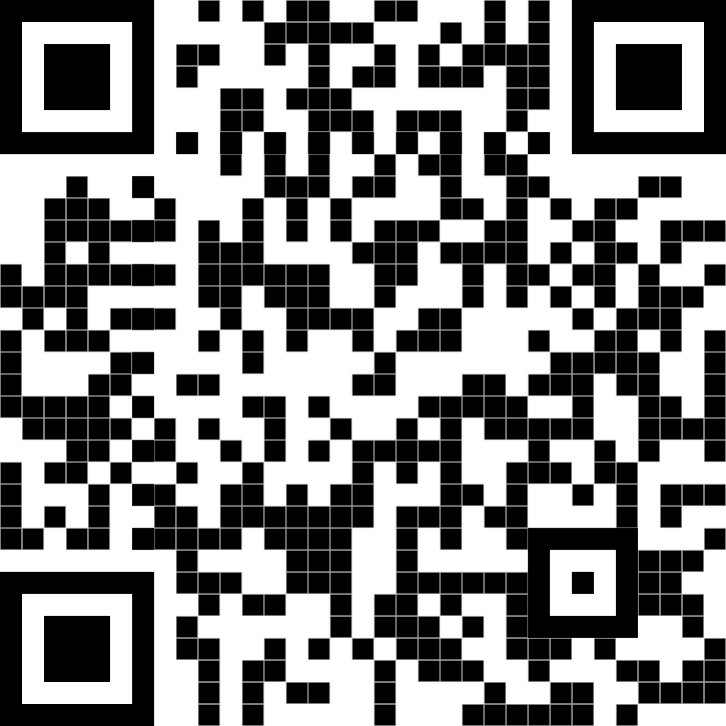
Contact Information
College of Education and Human Development Institute on Disabilities at Temple University Ritter Annex 4 | Room RA 430 1301 Cecil B. Moore Avenue Philadelphia, PA 19122
Phone 215-204-1356 Email IOD@temple.edu Web disabilities.temple.edu

