Slide 1
Transition to High School
Institute on Disabilities at Temple University
Families Reimaging Inclusive Lives (FRIL)

Slide 2
Institute on Disabilities at Temple University Pennsylvania’s University Center for Excellence in Developmental Disabilities Education, Research and Service
hi
VISION
A society where all people are valued and respected, and where all people have the knowledge, opportunity and power to improve their lives and the lives of others.
MISSION The Institute on Disabilities at Temple University learns from and works with people with disabilities and their families in diverse communities across Pennsylvania to create and share knowledge, change systems, and promote self-determined lives so that disability is recognized as a natural part of the human experience.

Slide 3
Families Reimaging Inclusive Lives (FRIL) project is funded by the Pennsylvania Developmental Disabilities Council (PADDC).

Slide 4
Objectives
Be prepared for meetings with new IEP team
Encourage self-advocacy
Identify similarities and differences between transition to middle school and transition to high school

Slide 5
Transition includes...
Early intervention to kindergarten
Elementary school to middle school
Middle school to high school
And finally... high school to adulthood (employment or post-secondary opportunities)
Notes:
Transition includes the move from Middle to High School. This is a crucial time of change for young teens, emotionally and academically.

Slide 6
PREPARING YOUR CHILD FOR THE TRANSITION
Meeting the new team and questions to consider
Notes:
Set them up for success by being prepared.

Slide 7
Tips for Meeting High School IEP Team
Invite high school IEP team to final middle school IEP meeting
This ensures direct and open communication with educators
Builds trust and accountability on both sides for the child
Encourages student participation
Request a meeting before new school year, or no later than the first week of school
Notes:
Tips for meeting the HS team. Can you think of others?

Slide 8
Does the IEP "Fit"?
When meeting the school team, be sure to discuss the effectiveness of the IEP
Make changes, edits, or additions as needed
Keep in mind that anything in the IEP should be accessible to be implemented at school AND home
Caregivers and educators should work together
Notes:
If something was not working in Middle School, don't hesitate to make changes before HS begins.

Slide 9
Questions To Ask
What is the plan for graduation?
What is their class schedule?
Will they have necessary accommodations in place?
Which support services are provided and how often?
Are extracurricular activities accessible and available for them to join?
Notes:
Come prepared with your questions. Others?

Slide 10
BUILDING SELF-ADVOCACY
"I can advocate for myself"

Slide 11
Student Led IEPs
Use the IEP to practice lifelong skills in a safe environment
Student-led IEPs are about getting the students involved in their education
It can take various forms with the hope that by high school, students are close to running the meeting
Transition planning can also help students prepare for life after high school, such as employment, higher education, and independent living.

Slide 12
Who is a Good Candidate...All Students!
Introduce Self and/or Others
Goal of leading own IEP meeting
Prepare visual aid (i.e. PowerPoint)
"All About Me”
Cooperatively develop all aspects of the IEP
Chair the meeting
Notes:
Students can participate starting in elementary school. By high school students can be running their own meeting. Remember that there is a continuum of involvement, not everybody starts in the same place.

Slide 13
Preparation in the IEP Meeting
Students Rubic for IEP Participation
Area | Level I | Level II | Level III | Level IV
IEP Awareness | I don’t know what IEP stands for. | I know what IEP stands for. | I know what IEP stands for and the purpose of the IEP meeting. | I know what IEP stands for, the purpose of an IEP meeting and I can tell others about these meetings.
IEP Participation | I don’t participate or attend my IEP meetings. | I attend a pre-conference IEP meeting and/or my IEP meeting but I don’t participate in the meeting. | I attend and contribute information about myself for my IEP in a pre-conference or at the actual meeting | I lead parts or my entire IEP meeting.
Knowledge of IEP Content | I don’t know what is in my IEP. | I know that I have accommodations and goals but I don’t know what they are. | I can name the accommodations and goals in my IEP, but I don’t have a voice in developing them. | I can name the accommodations and goals in my IEP and I have a voice in developing them.
Notes:
From the Peal Center https://www.pealcenter.org/wp-content/uploads/2020/09/Participation-in-IEP-rubric.pdf

Slide 14
Parent Benefits
Increased parent involvement and voice
Improved communication with teacher
More self-determined youth
Positive interaction with school personnel
Notes:
Often, parents of students with disabilities have negative interactions with school. This is a chance to reverse that trend. Also, students often open up to teachers more and this is a chance for everyone to get on the same page.

Slide 15
Student Benefits
Better understanding and awareness of …
Disability
IEP process and relevance
Self-determination skills
Notes:
Many students don’t know what their disability is and can’t name any accommodations they receive. Part of being self-determined is understanding your rights and responsibilities including IDEA 04 vs. ADA (entitlement vs. eligibility). Students need the opportunity to practice self-determination skills, this is a great opportunity for them. Greater student involvement makes IEP relevant and may lead to greater goal attainment.

Slide 16
What Self-Advocacy Can Look Like In High School
Set Up/Invitations/Introduction
Present Levels
Goal Writing and Objectives
Progress Monitoring
Specially Designed Instruction
Transition Grid
Notes:
From PaTTAN https://www.youtube.com/watch?v=ZFRMiAcMQsc

Slide 17
A Parent's Experience with SLIEP
Notes:
49:26-51:52 : parent talking about the value of having child involved in IEP meetings (in Spanish with English subtitles)

Slide 18
A Parent's Experience with SLIEP
Notes:
16:20-19:25

Slide 19
Ishaan's Student Led IEP
Notes:
24:49-28:59

Slide 20
TRANSITION CONSIDERATIONS
Preparing for High School

Slide 21
When to Begin
Under federal mandate, all students at the age of 16 with an IEP should have an individualized transition plan.
However, transition planning should ideally begin when a student is in middle school.
It gives the student, family, and educators enough time to develop and implement an effective plan before the student begins high school.

Slide 22
Similarities...This Looks Familiar
Accessibility of school building
When and where services will happen
Navigating switching classes and other physical considerations
How special equipment will be supported in the classrooms
Extracurricular opportunities
Prepare for transition with school visits and meeting teachers on IEP team

Slide 23
Differences...What Will Change?
Increased importance of student involvement
Becoming more independent
Building upon advocacy skills
Have student create goals and action plan

Slide 24
Research shows:
Research shows:
Parent's expectations are the MOST important factor in a successful transition.
Notes:
https://supportstofamilies.org/wp-content/uploads/parent-expectations_D21.pdf
"The most powerful force in changing transition
outcomes for young people with significant
disabilities is not ultimately found in the transition
plans we craft, the educational services we offer, the
instruction we provide, or the systems we build, but
rather in the expectations and aspirations individual
parents hold for their
sons and daughters. All
of these other efforts
are no doubt essential,
but absent families
equipped with a clear
and compelling vision
for a “good life” after
high school, we are
missing something
utterly essential."

Slide 25
Questions
Notes:
What questions do you have? What is something new you learned? What stood out the most?

Slide 26
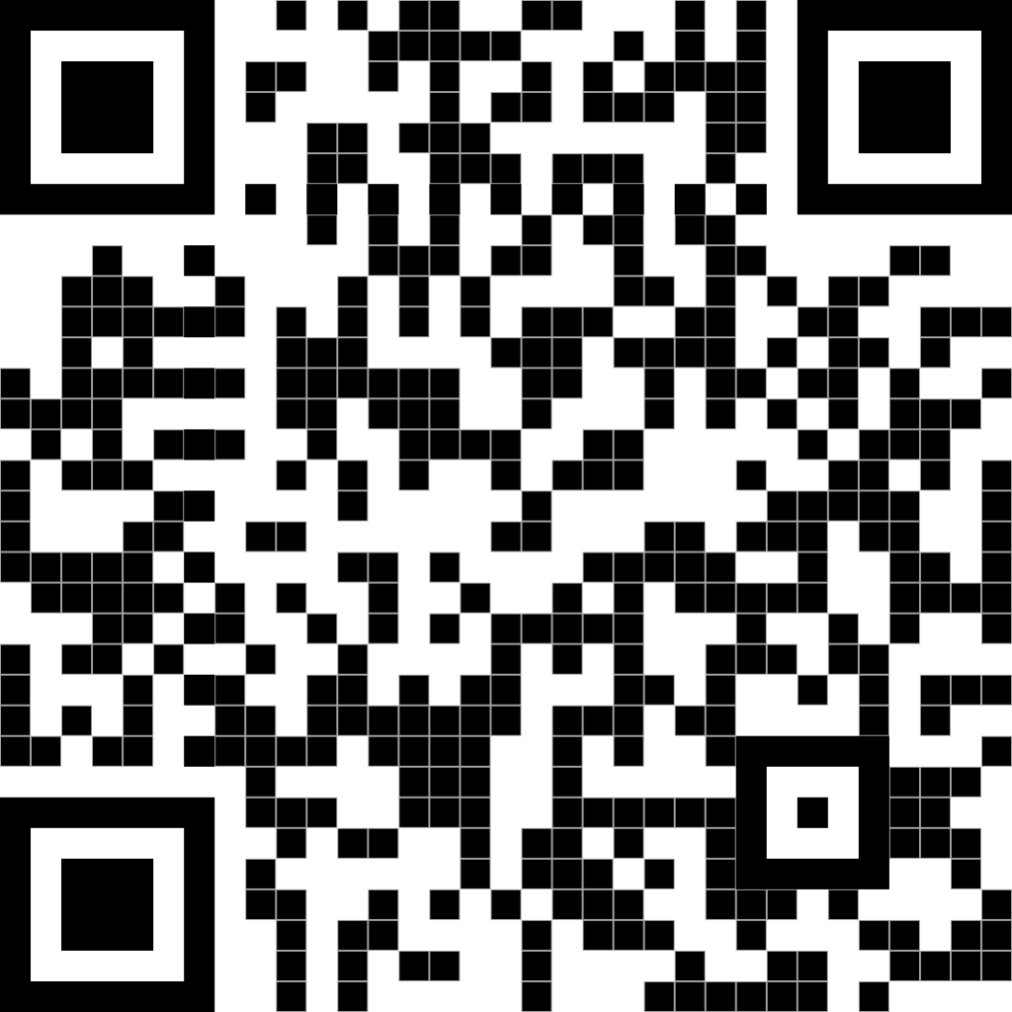
Contact Information
College of Education and Human Development Institute on Disabilities at Temple University Ritter Annex 4 | Room RA 430 1301 Cecil B. Moore Avenue Philadelphia, PA 19122
Phone 215-204-1356 Email IOD@temple.edu Web disabilities.temple.edu

