Slide 1
Transitioning your Child from Early Intervention to Kindergarten
Institute on Disabilities at Temple University
Families Reimaging Inclusive Lives (FRIL)
Notes:
Welcome. Today we will talking about Transitioning Your Child from Early Intervention (EI) to Kindergarten

Slide 2
Institute on Disabilities at Temple University Pennsylvania’s University Center for Excellence in Developmental Disabilities Education, Research and Service
hi
VISION
A society where all people are valued and respected, and where all people have the knowledge, opportunity and power to improve their lives and the lives of others.
MISSION The Institute on Disabilities at Temple University learns from and works with people with disabilities and their families in diverse communities across Pennsylvania to create and share knowledge, change systems, and promote self-determined lives so that disability is recognized as a natural part of the human experience.

Slide 3
Families Reimaging Inclusive Lives (FRIL) project is funded by the Pennsylvania Developmental Disabilities Council (PADDC).

Slide 4
Objectives
Identify differences between eligibility for special education in Early Intervention and School-Age programs
Understand options for developing an Individualized Education Plan (IEP)
Understand the importance of informed decision making in determining educational placement
Understand the parent’s role and rights in the child’s education
Notes:
Review Objectives

Slide 5
Background Information
Things to Keep in Mind

Slide 6
Poll the Audience
How many of you have heard some of the acronyms when talking about special education?
IEP LRE ESY OVR
Notes:
There are so many acronyms used in education and special education. Often parents and students don't even know what they mean. Knowing where to find the list of acronyms is crucial.
IEP= Individualized Education Program
LRE= Least Restrictive Environment
ESY= Extended School Year
OVR= Office of Vocational Rehabilitation

Slide 7
Special Education Acronyms
AT = Assistive Technology
LEA = Local Educational Agency
EI= Early Intervention
ESY = Extended School Year
FAPE = Free Appropriate Public Education
FERPA = Family Educational Rights and Privacy Act
FBA = Functional Behavioral Assessment
IDEA= Individuals with Disabilities Education Act
IEP = Individualized Education Program
IFSP = Individualized Family Service Plan
LRE = Least Restrictive Environment
Notes:
Here are some commonly used acronyms in Special Education. (ABCs of Education https://www.pattan.net/Publications/Education-ABCs ) You can also download or share this link with families to support them.

Slide 8
Special Education Acronyms con t’d
NOREP = Notice of Recommended Educational Placement
OHI = Other Health Impairment
OSEP = Office of Special Programs
OVR = Office of Vocational Rehabilition
PBSP = Positive Behavior Support Plan
PDE = Pennsylvania Department of Education
RR = Reevaluation Report
SDI = Specially Designed Instruction
504 Plan = Provides accommodations to students with a disability
Notes:
Here are some commonly used acronyms in Special Education. (ABCs of Education https://www.pattan.net/Publications/Education-ABCs ) You can also download or share this link with families to support them.

Slide 9
IEP vs. 504 Plan
IEP
Required because of IDEA (an education law)
Provides specialized instruction
Focuses on what the student is learning
State receives additional funding for eligible students
Person needs to have one or more of the 13 listed disabilities
504 Plan
Required because of Rehabilitation Act (a civil rights law)
Provides accommodations
Focuses on how the student is learning
State receives additional funding for eligible students
Person has any disability
BOTH
Parents must consent to have child evaluated
No cost to parents
Works to meet the needs of the person receiving the plan
Notes:
You may know some students with a 504 Plan instead of an IEP. What is the difference between a 504 Plan and an IEP?
Let's look at the Venn diagram to see the similarities and differences. The space in the center is for BOTH.

Slide 10
Introduction to Transition
What You Need to Know

Slide 11
While some define transition as solely the transition to adulthood...
Notes:
Intro to transition planning

Slide 12
Transition includes...
Early intervention to kindergarten
Elementary school to middle school
Middle school to high school
And finally... high school to adulthood (employment or post-secondary opportunities)
Notes:
Transition includes many steps along the way. The first that we will discuss today is the Transition from Early Intervention to Kindergarten.

Slide 13
Why Inclusion Matters
Inclusion means that a person with a disability has the same rights, access, and choices as everyone else in the community.
Inclusion is a universal human right.
Notes:
Ask the group: Can you think of some other reasons why inclusion matters? Or anything to add?

Slide 14
What to Expect
Eligibility & Transition Steps

Slide 15
Eligibility: Early Intervention
Services and supports available to children from birth to 5 with developmental delays and disabilities
Publicly funded programs provide services for free or at reduced cost for any child who is eligible
Notes:
Let's look at the eligibility criteria for Early Intervention

Slide 16
Eligibility: School-Age Programs
All children eligible for preschool early intervention services remain eligible for special education
Unless the student is reevaluated and found no longer eligible for special education
Notes:
Here are the eligibility requirements for school-age programs

Slide 17
Transition Steps
February 1st before child is eligible for kindergarten
By the end of February
Transition Meeting
Dates depend on district
Register for kindergarten!
Receive a letter about the Transition Meeting
Notes:
Here is a map to the Steps to Transition. Let's start at the top Left. Go through each step.
NOTE: Dates may differ depending on what school district you are in.

Slide 18
Receive "Notice of Your Child's Transition to School Age Meeting"
Preschool Early Intervention programs will send this letter by February 1st to inform parents that their child is eligible to begin kindergarten or first grade.
Notes:
When parents receive the notice for their child's transition meeting, it is very important that they attend. This is where they can ask all their questions about kindergarten and the services their child will receive.
Ask the group: Why else do you think it is important for parents to attend the transition meeting?

Slide 19
Transition Meeting
Parents should complete an "Intent to Register" form to indicate the plan to enroll their child in a public or charter school
Receive "Notice of Options For Your Child's Transition"
Continue EI Preschool IEP and/or add revisions
Conduct a reevaluation
Notes:
Link to an annotated "Intent to Register" form https://www.education.pa.gov/Documents/Codes%20and%20Regulations/Basic%20Education%20Circulars/Purdons%20Statutes/Attachment%202%20-%20Intent%20to%20Register%20for%20Kindergarten.pdf

Slide 20
Option: EI for Additional Year
If there are concerns about the child moving on to kindergarten, discuss them in the Transition Meeting.
If decided to delay entering school-age programs, a child can continue to receive preschool early intervention services for one more year.
Notes:
If the parent decides to hold their child back in preschool for an additional year, there are no repercussions. The parent has the right to do so and the child will have access to the same services and supports from the year before.

Slide 21
Register for Kindergarten
Dates and how to enroll will be discussed in the Transition Meeting
NOTE: Attending the Transition Meeting is not registering for kindergarten.
Notes:
Just because you attend the transition meeting does not mean your child is registered for kindergarten.

Slide 22
Parent/Caregiver Role & Rights
You are the expert on your child
Notes:
In order for parents to be the best advocate for their child, they should know their rights and what the child is entitled to.

Slide 23
Six Tips for Helping Parents Advocate
Understand your child's disability
Know the key players (IEP & school team)
Know your rights and responsibilities
Become well-organized (Keep all documents in one place)
Ask questions of the team
Know how to resolve disputes, if they arise
Notes:
Here are 6 tips to help parents become better advocates.
1- understand child's disability- knowing if it impacts them cognitively (academically), emotionally, or physically
2- Get to know the IEP team- who are the people in the meeting; what is their job; will they be working with your child?
3- Know your rights- ask for additional support, services, help from the school team
4- Being well organized is important- there are lots of documents to sign and information you may need each year. Keep it in a binder or folder OR scan and save to your computer.
5- Don't forget to ask questions. Write them down before or during the meeting.
6- If you disagree or have a dispute, know who to contact. Mediation is available.

Slide 24
Developing an IEP with Inclusion in Mind
Encourage inclusive practices from the start!

Slide 25
Options for Kindergarten IEP
Adopt the EI IEP (Looks great, no changes needed.)
Adopt the EI IEP with revisions (Looks good, some changes needed.)
Reevaluation (Full reevaluation may be needed based on misdiagnosis or new behaviors.)
Notes:
There are 3 things that could happen when having your first IEP meeting in Kindergarten.

Slide 26
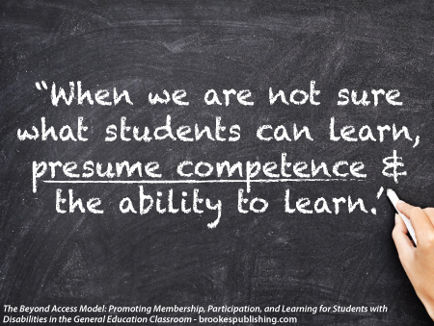
Presuming Competence
Notes:
What are some ways you presume competence of your child or a person with a disability?
How would you like others to presume competence of you?

Slide 27
Shelley Moore's "5 Moore Minutes"
Notes:
Some of you may be familiar with Shelley Moore. Her video series is all about facets of Special Education. The series is called 5 Moore Minutes. This one is about Presuming Competence. ( Play whole video)

Slide 28
Presuming Competence Looks and Sounds Like
Focus on student abilities and needs.
Avoid language that classifies students on developmental or functional level.
Provide all students the opportunity to communicate about same topics as their non-disabled peers.
Notes:
Take note if you are hearing or seeing these things in your child's classrooms, from parents you know, or did you hear them yourself? Any examples people want to provide?

Slide 29
Presuming Competence Looks and Sounds Like cont’d
Annual goals in IEPs reflect standards from the general education curriculum
Don’t predict certain students will never acquire certain knowledge or skills.
Use age-appropriate vocabulary, topics, and inflection when talking to students.
Notes:
Take note if you are hearing or seeing these things in your child's classrooms, from parents you know, or did you hear them yourself? Any examples people want to provide?

Slide 30
Least Restrictive Environment (LRE)
All students with an IEP have the right to an education in the least restrictive environment.
Meaning, they should be included in the general education curriculum and with their peers without disabilities as much as possible.
Notes:
The Individuals with Disabilities Education Act (IDEA) requires all students with disabilities to be educated in the Least Restrictive Environment (LRE). This may look different for all students. Don't assume the inclusion classroom is the LRE. But we should give all students the opportunity to be in class with their non-disabled peers BEFORE moving to a more segregated setting.

Slide 31
Why is this important?
Research shows that:
The child with a disability
The child with a disability's peers or classmates
The classroom teacher
The family
ALL benefit from the inclusion of students with disabilities
Notes:
What does the Research tell us?

Slide 32
Exclusion. Integration. Segregation. Inclusion
Notes:
Here is a visual representation of what inclusion looks like. We have come so far but there is still room for growth. (Describe each circle)

Slide 33
Transition Strategies
Help prepare your child for the next steps

Slide 34
Visit the New School
Schedule visiting days so you and your child can become familiarized and to identify needs for support
Communicate concerns to new school staff and IEP team
Introduce your child and share their strengths
Focus on the positives
Notes:
(Some content borrowed from the PEAL Center.)

Slide 35
Introducing your Child: Student Snapshot
Create a one-page document to easily and succinctly communicate information about your child to school staff.
Ideas of what to include:
Current photo
Likes/dislikes
Strengths/challenges
Motivated by/discouraged by
And anything else you and your child think is important for staff to know!
Notes:
https://www.pacer.org/parent/php/php-c160.pdf (Sample on next slide)

Slide 36
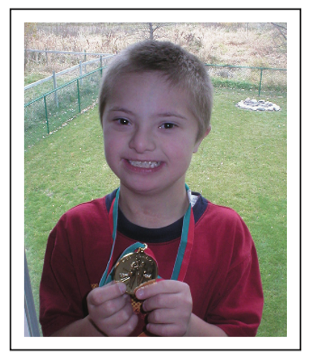
Introducing Joe Smith
Joe Smith at a Glance
Current Interests: Spongebob Squarepants@, playing the drums, Twins' baseball
Likes: Computers, electronics, art and media materials
Dislikes: noisy environments, touching or tasting unfamiliar foods
Motivated by: Coaching style: setting and reaching goals, "high fiveS:' humor (good-natured teasing); social interaction; grades and awards
Turned off or discouraged by: Stern or angry responses, being singled out publicly
Notes:
Sample student snapshot

Slide 37
Introducing Joe Smith 11
Joe's Strengths to Build Upon
Good auditory memory; learns best by listening
Musical: rhythm, rhyme and melodies reinforce learning
Cooperative: works well in teams or small groups
Understands limits: able to follow rules
Uses laptop computer independently
Supportive and involved family
Notes:
Sample student snapshot

Slide 38
Introducing Joe Smith 2
Joe's Challenges and Ways to Address Them
No hearing in left ear: Speakers need to sit, stand, and walk on his right side.
Younger developmental age: Close adult supervision needed for vulnerability and safety, especially during unstructured times like recess, lunch , and hall passing times
Poor fine motor skills: needs extra time, adapted materials, and some personal assistance for writing or drawing and self-help activities.
Poor large muscle coordination and balance: Needs extra time and more space going up and down stairs and moving through halls
Notes:
Sample student snapshot

Slide 39
Introducing Joe Smith 3
Our Long-range Goals for Joe:
To participate as much as possible in school with the people with whom he will live in the community as an adult (regular education peers)
To reach his potential in basic areas: reading, math, written language
To develop age-appropriate behavior and social skills
To learn what he has to offer others and to feel a responsibility to make a contribution
To increase his attention span and tolerance for mentally and physically challenging activities
Notes:
Sample student snapshot

Slide 40
Introducing Joe Smith (4
Our Focus for Joe this School Year:
To make measurable progress in reading, especially decoding
To learn appropriate conversational skills with peers
To make a friend with whom to connect outside of school
Notes:
Sample student snapshot

Slide 41
Transition Planning
Parents and caregivers transition plan with EI staff
Collaborate and work together as a team
Make sure to come prepared with questions
Let's look at a sample....
Notes:
Added from PEAL presentation

Slide 42
The TRANSITION PLAN will look like this:
X. Transition Plan
A transition plan should be completed for children as identified in the Special Considerations section of the IEP
*This plan will be developed during an JEP review meeting and in collaboration with yourself and your child's IEP team, during this transition year.
Transition Outcome/Goal:
What is happening now?
What information and child and family considerations should be shared with the team in order to better prepare for transition?
Notes:
"Collaborate with your EI and Preschool staff to create a transition plan"
Let's have a look at the Transition Plan which is part of the IEP Process (when age appropriate)

Slide 43
The TRANSITION PLAN continued :
Activities/Services Designed to Ensure a Smooth Transition from Early Intervention to Kindergarten The plan should include at least the following: | Person Responsible | Date to be Completed | Actual Completion Date
1. Discussions with the parent regarding future support and other matters related to transition
2. Steps to prepare the young child for changes based on developmental needs, including activities to help the adjustment to and participation in new settings
3. Steps to ensure a smooth transition, including sharing of information, and convening a meeting with the family, community provider, or school district by February 28, of the current program year for preschool EI
Notes:
"Collaborate with your EI and Preschool staff to create a transition plan"
Let's have a look at the Transition Plan which is part of the IEP Process (when age appropriate)

Slide 44
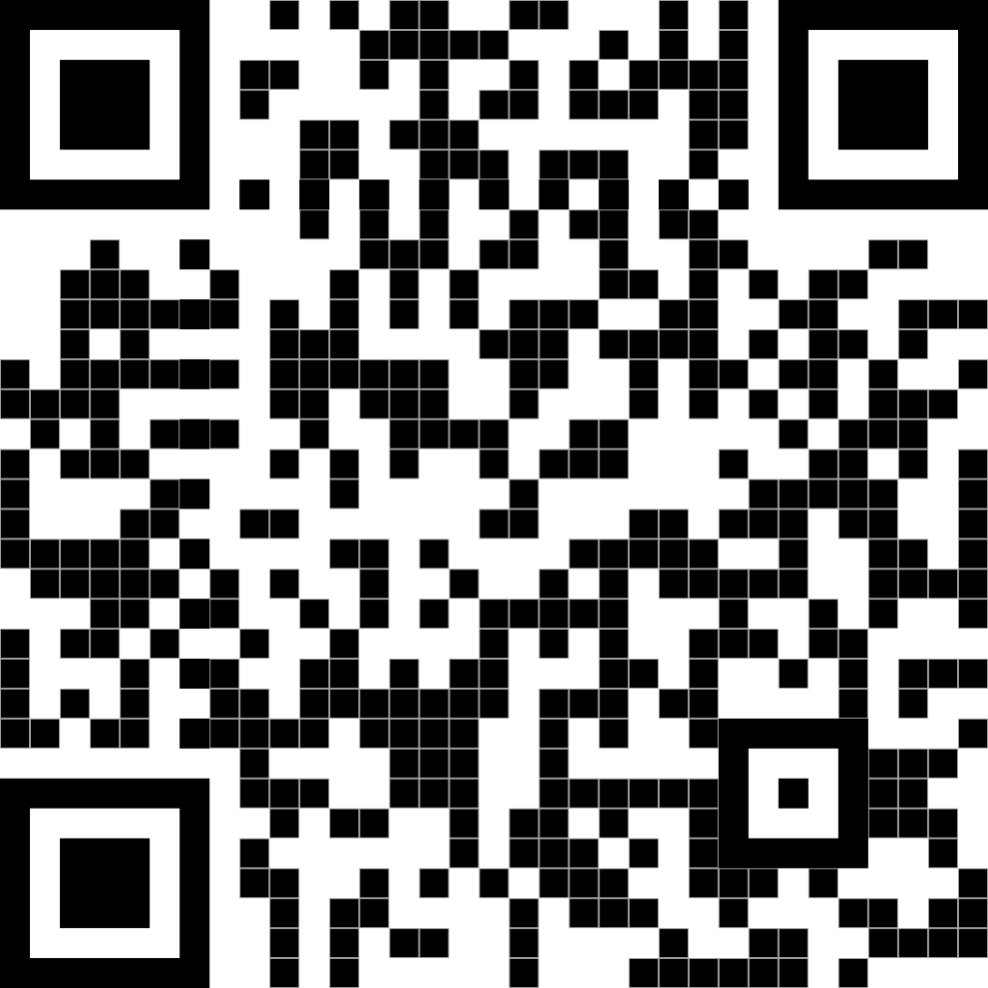
Contact Information
College of Education and Human Development Institute on Disabilities at Temple University Ritter Annex 4 | Room RA 430 1301 Cecil B. Moore Avenue Philadelphia, PA 19122
Phone 215-204-1356 Email IOD@temple.edu Web disabilities.temple.edu

Slide 45
Questions
Notes:
What questions do you have? What is something new you learned? What stood out the most?

