Slide 1
Person-Centeredness
Welcome and Introductions

Slide 2
Icebreaker Exercise

Slide 3
Overview of Session
Explain elements of person-centered thinking and planning
Identify examples of person-centered supporting practices
Develop more confidence in collaborating with professionals
Participant Input: What do you want to learn?

Slide 4
Introduction to Person Centeredness
Historical view of this movement and why it is important
Video: Kahn and Pearpoint (Next slide)
Large Group Debrief/Discussion
Round Robin: Feedback on Module

Slide 5
Conversation with Jack Pearpoint and Lynda Kahn

Slide 6
break

Slide 7
Person Centered Thinking
Overview of Skills and Tools
Important To/Important For
4+1
What’s Working, What’s Not
Matching Tool
Communication Log

Slide 8
Person Centered Thinking continued
Exercise: What tools will you use?
Why?
How?
Large Group Debrief/Discussion
Round Robin: Feedback on Module

Slide 9
lunch

Slide 10
Review Morning Modules

Slide 11
Person Centered Planning
Overview of Skills
Amplifying the Voice of the Person
Facilitation
Setting Up the Planning Conversation
Select Tools/Format:
Planning Alternative Tomorrows with Hope (PATH)
Charting the LifeCourse Framework (CtLC)

Slide 12
Person Centered Planning continued 1
Overview of Skills
Consensus Building around the Person’s Right to Risk
Supported Decision Making
Focus on Person and their Community

Slide 13
Building Community with Beth Mount
This optional video is not essential to the the toolkit training. Please note it is not captioned. (https://player.vimeo.com/video/64586570?app_id=122963)

Slide 14
Person Centered Planning continued 2
Video: Beth Mount, Building Community
Small Group Exercise:
Three Things about You
Three Things about your Community
Large Group Debrief/Discussion
Round Robin: Feedback on Module

Slide 15
Person Centered vs System Centered with Beth Mount

Slide 16
Break 2

Slide 17
Person Centered Supporting To Each Their Own
Overview of Expectations and System Roles:
Using Person Centered Thinking and Planning to Create a Good Life
Video: Beth Mount, System vs Person Centered
Small Group Exercise:
What Are Your Expectations?
Large Group Debrief/Discussion
Round Robin: Feedback on Module

Slide 18
Break 3

Slide 19
Bringing It All Together
What did you learn?
How will you use this learning?
What will you do in the next 24 hours? 1 week? 1 month?
Activity
Dates
Accountability Partner

Slide 20
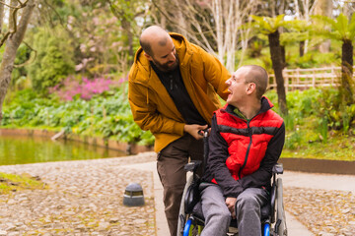
Acknowledgements and Adjourn

Slide 21
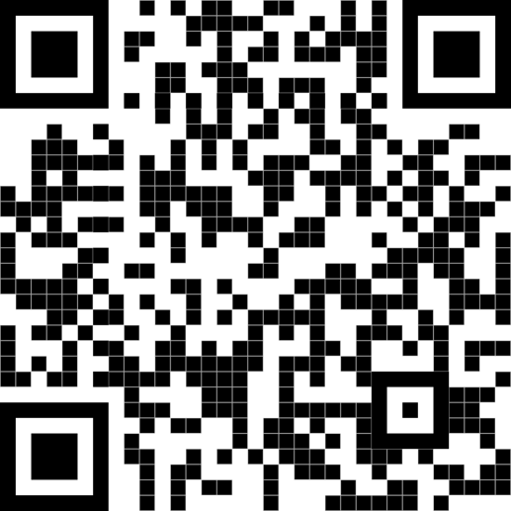
Contact Information
College of Education and Human Development Institute on Disabilities at Temple University Ritter Annex 4 | Room RA 430 1301 Cecil B. Moore Avenue Philadelphia, PA 19122
Phone 215-204-1356 Email IOD@temple.edu Web disabilities.temple.edu

Slide 22
Links to Videos
Person-Centered with Pearpoint and Kahn
https://youtu.be/O0Q43Xss9FQ?si=LFA9TQ50Kc2inl5P
Building Community with Beth Mount
https://vimeo.com/64586570
System vs Person Centered with Beth Mount
https://youtu.be/y77y7XW8GtE?si=wSbARXUhI5Ns7Xrt

