Slide 1
Home and Community Based Services (HCBS) Special Interest Group (SIG)
Presented By: Sarah Swanson, AUCD Consultant
Jon Neidorf, Caitlin Crabb, Wanda Felty
June 5, 2024
Notes:
Thanks to everyone for attending this session!

Slide 2
The AUCD HCBS SIG
Housekeeping Items
If you have any technical difficulty, please type in the chat to let us know.
Becky Willis, AUCD staff is available to help.
Thanks to ACL, the Human Services Research Institute (HSRI), and the AUCD’s Community Inclusion team.

Slide 3
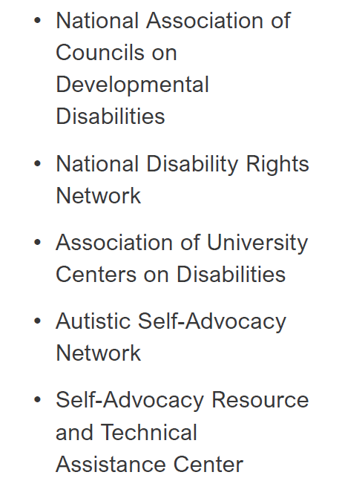
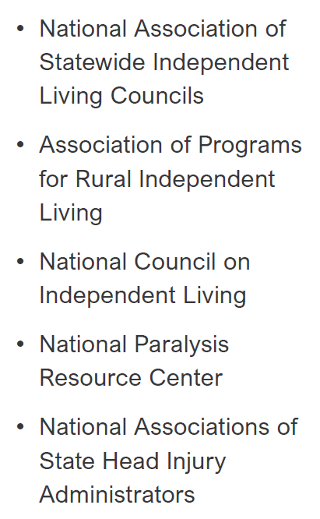
Administration for Community Living (ACL)
Human Services Research Institute (HSRI)

Slide 4
The AUCD HCBS SIG
Welcome and Introductions
In the chat, please write:
your name,
organization, and
interest in this meeting

Slide 5
The AUCD HCBS SIG
Agenda

Slide 6
HCBS SIG Goals
Identify best practices related to compliance with the CMS HCBS Settings Rule
Stay current on ACL and CMS actions and priorities related to the Heightened Scrutiny process and on-going compliance
Learn from other UCEDDs opportunities for contracting

Slide 7
HCBS SIG Goals
Partner with individuals with disabilities and other stakeholders to improve HCBS
Empower people with disabilities and family leaders to actively participate in the public comment period for new waiver applications, waiver renewals, and activities related to compliance with the HCBS settings rule
Leverage waiver services available to support the full inclusion of people who need Long-Term Services and Supports (LTSS) and their families

Slide 8
Updates
New Rules by the Centers for Medicare and Medicaid Services (CMS)
Access Rule
504 Rehabilitation Act
Other

Slide 9
Updates
CMS’ Access Rule
ACL Website on Access Rule:
https://acl.gov/news-and-events/acl-blog/medicaid-access-rule-historic-regulation-strengthen-home-and-community
CMS Website on Access Rule:
https://www.cms.gov/newsroom/fact-sheets/ensuring-access-medicaid-services-final-rule-cms-2442-f

Slide 10
Updates
Opportunities for Involvement
In your state
Medicaid Advisory Committee
Beneficiary Advisory Council (BAC)
Interested Parties Advisory
Engaged in how this rule gets implemented

Slide 11
“The Grassroots Project”
AUCD’s Workplan

Slide 12
Invitation to Monthly Meetings
June 26
August 7
September 4
October 2
November 6
Dec 4
Registration Link:
https://us06web.zoom.us/meeting/register/tZIscOqoqTgsHddu-70AiNbzaMyUDFHuVrIh#/registration

Slide 13
The Grassroots Project
Opportunities for Stakeholder Engagement and Public Comments
CMS Calls and State Visits
Medicaid Waiver Public Comment Periods

Slide 14
CMS Calls and State Visits
An opportunity to share what’s going on in your state
Share concerns with state leadership and CMS
Get technical assistance from ACL leadership
Notes:
The HCBS Settings Rule is all about Human and Legal Rights for people in need of LTSS. (There is confetti in the background of this statement)

Slide 15
CMS State Visits
2 Different CMS Divisions with different focus:
MCOG: Health & Welfare Visits
MBHPG: HCBS Visits
(HCBS Settings Rule Compliance)

Slide 16
CMS State Visits
KEY:
* = MCOG Health and Welfare Visit ^ = MBHPG HCBS Visit
CA - June 2023^
GA - April 2024 ^
ID - Sept. 2023^
IL - Oct. 2022^
IN - Nov. 2022^
IA - June 2024
KS - March 2023
MI - July 2024^
MN - July 2022^
NH - May 2024*
NM - Sept. 2024^
NY - July 2023^
OH - May 2022^
OR - April 2023^
PA - Feb. 2024*
SC - Jan. 2023^
SD - May 2024^
TN - March 2024*
TX - Feb. 2023^
VT - June 2022^
VA - March 2024*
WA - Sept. 2023*
WI - July 2022 ^

Slide 17
CMS State Visits
Key Steps
UCEDD contacts will get email by ACL Leadership
I will reach out to see if you want to meet
ACL call to offer technical assistance
CMS call with state stakeholders who share

Slide 18
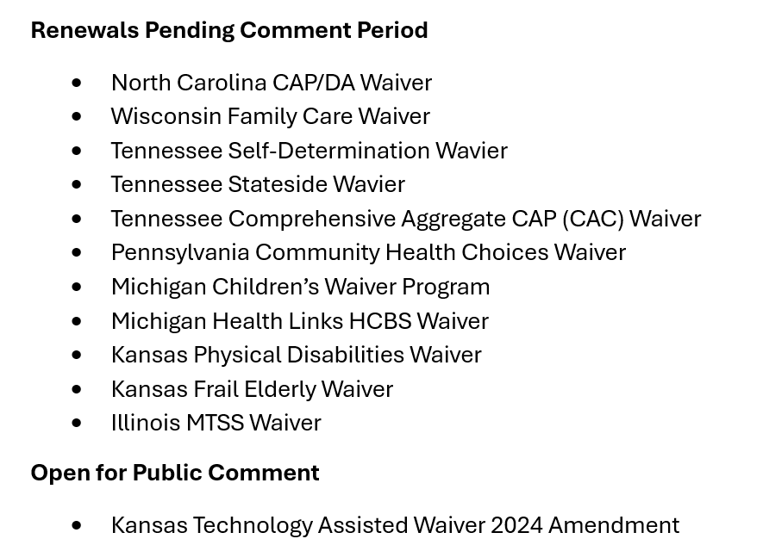
Medicaid Waivers

Slide 19
Medicaid Waivers
Waivers under review by CMS:
Colorado Developmental Disabilities Waiver
Colorado Supportive Living Services Waiver
Colorado Children’s Residential Habilitation Waiver
Colorado Children’s Extensive Supports Waiver
Delaware DDDD Lifespan Waiver
Iowa Intellectual/Developmental Disabilities Waiver
Kansas I/DD Waiver
Kansas Brain Injury Waiver
Louisiana Supports Waiver
Louisiana Children’s Choice Waiver
Maine for Members with Brain Injury Waiver
Maryland Waiver for Children
Massachusetts Traumatic Brain Injury Waiver
Missouri Brain Injury Waiver
North Carolina Innovations Waiver
Ohio Assisted Living Waiver 2023 Amendment
Ohio IO Waiver 2023 Amendment
Oregon Medically Fragile Waiver
Oregon Behavioral ICF/IDD Waiver
Virginia Community Living Waiver
Florida DD Individual Budgeting Waiver
Missouri Independent Living Waiver
North Dakota IDD HCBS Waiver
Utah Acquired Brain Injury Waiver

Slide 20
Medicaid Waivers
Collecting past public comments to send to HSRI for review
Host Office Hours to ask questions
Work in coalitions to submit comments

Slide 21
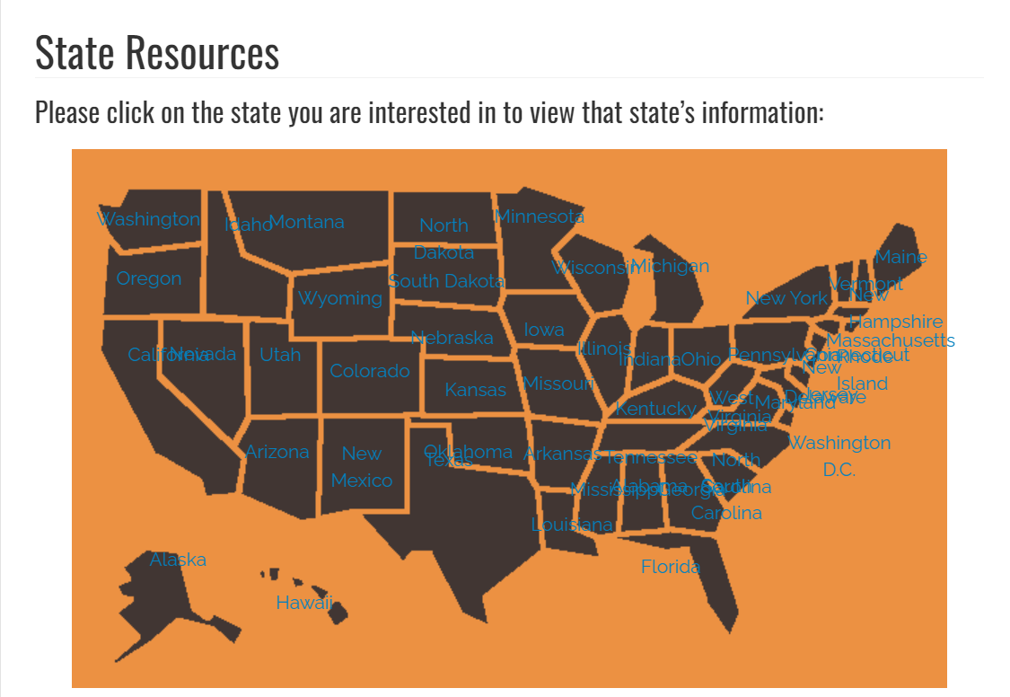

Slide 22
HCBS SIG Workgroups

Slide 23
Knowledge Translation
Chair: Jon Neidorf
The knowledge translation (KT) workgroup will share tools people can use to make public comments on waivers that are up for renewal. We will help advocates share information in a way that policymakers can understand and improve services. These products will also be accessible so people with disabilities can understand and use them.
Next workgroup meeting on June 20.
For information: Jon Neidorf <jneidorf@umn.edu>

Slide 24
Quality
Chair: Caitlin Crabb
The Quality Workgroup aims to support self-advocates in understanding what quality means and how to advocate for better quality within their Medicaid Home and Community-Based Services (HCBS) waivers. The first activity of the Workgroup will be to define quality in the context of HCBS waivers in an accessible manner. Then, the Workgroup will identify an area or two of focus as it relates to quality within Medicaid Home and Community-Based Services (HCBS) waivers. The focus area(s) may derive from the HCBS Settings Rule; the HCBS Access Rule; or other areas that workgroup members identify as important. Once the focus area(s) have been identified, members will work together to identify accessible products/activities to develop in support of the focus area(s).
Tentatively scheduled for the third Tuesday of the month from 1-2pm CT
For more information contact: Caitlin Crabb <ccrabb2@uic.edu>

Slide 25
Stakeholder Engagement
Chair: Wanda Felty
Support stakeholders in advocacy
Keep stakeholders informed on opportunities to make comments
Provide examples of opportunities for advocacy and leadership (individual and at a systems-level)
Help develop materials written in plain language so it’s accessible to everyone
Provide examples of public comments so that people receiving HCBS have the life they desire.
Teach researchers how they can provide information to stakeholders on quality in plain language
Provide a resource list of individuals and organizations where stakeholders can get more information and get connected
Monthly meeting: To be determined
For more information contact: Felty, Wanda (HSC) <Wanda-Felty@ouhsc.edu>

Slide 26
The AUCD HCBS SIG
News From the Network
Any Innovations?
Cool things to share?

Slide 27
The AUCD HCBS SIG
News From the Network
What do you want to
learn more about?

Slide 28
The AUCD HCBS SIG
Any Questions?

Slide 29
The AUCD HCBS SIG
Please Help Us By
Completing this Survey:
Engagement Survey

Slide 30
The AUCD HCBS SIG
Next Meeting Date:
June 26, 2024
from 11-12 CT

