Slide 1
Nuts and Bolts of IM4Q
For Program Coordinators

Slide 2
Understanding the History/ Intent
In 1997 developed, Aim was to determine how people feel about services and supports
The IM4Q is a data source to ODP, the Administrative Entities and Providers for the Quality Improvement Plans.
Grassroots program that has grown and expanded.
Key role is that 51% of people who work as monitors or are on the board of the IM4Q must be a person with a disability or a family member.

Slide 3
IM4Q Process
Sample lists drawn from HCSIS and sent to the AE
Each Program determines how they will get the pre-survey information
Interviews Conducted and all information is data entered into two state databases
HCSIS pre-surveys, considerations, and Signs of Quality
ODESSA- EDE Data, NCI Data, Time Spent Data, State Center Supplement

Slide 4
Who can be interviewed?
NCI (National Core Indicators)
Must be receiving SC Services plus one other service
Age 18 and older
Can include those who reside at any of the State Centers
PFDS (Person Family Driven Services)
Must be receiving the PFDS waiver
IM (Independent Monitoring)
Age 3 and older
Can be receiving as little as SC Services only
AAW (Adult Autism Waiver)
Must be receiving the AAW Waiver
QA & I
Set number of individuals to be surveyed from ODP every 3 years
Not part of the IM4Q surveys but are their own set of survey questions

Slide 5

Resources
Background Checks
Medi- Checks
IM4Q Manual
HCSIS Training Manual
ODESSA Training Manual
Everyday Lives Document
Training Resources
Other Programs/ Monitors

Slide 6

HCSIS
Data Entry
Alerts
Closing the Loop Process
Reports Available

Slide 7

ODESSA
Data Entry
How to add surveys
Assigning Surveys
Reporting

Slide 8
ODP-BSASP-Adult Autism Waiver
Office of Developmental Programs (ODP)
Bureau of Community Supports (BCS)
Intellectual Disability/Autism Waivers (ID/A)
Works in conjunction with Administrative Entities (AE)
Bureau of Supports for Autism and Special Populations (BSASP)
Adult Autism Waiver (AAW)
Directly administers the waiver without AE
For IM4Q, the AE is involved only in the BSASP allocations.
Notes:
There may be some new staff, so we wanted to add a quick reminder of how the Adult Autism Waiver, or AAW, fits into the Office of Developmental Programs.
The Bureau of Community Supports, or BCS, oversees the Intellectual Disability/Autism Waivers or ID/A waivers for short.
BCS works in conjunction with Administrative Entities (AE). The Bureau of Supports for Autism and Special Populations, or BSASP, oversees the Adult Autism Waiver.
BSASP directly administers the AAW through BSASP Regional Office Representatives without assistance from the Administrative Entities.
For IM4Q, the AEs are only involved in the BSASP allocations.

Slide 9
AAW Sample and Pre-Surveys
AAW Sample and Pre-Surveys distributed by the BSASP IM4Q Regional Leads
Maximum of five individuals distributed
(3 to interview and 2 as an oversample)
Low AAW enrollment may lead some counties/county joinders to receive less than five.
Only AAW individuals interviewed in the prior year are excluded from the AAW sample. It is possible to be interviewed every other year.
Notes:
The AAW Sample and Pre-Surveys will be distributed by the BSASP IM4Q Regional Leads along with any AAW specific instructions.
The sample will include a maximum of five individuals. The first three are designated to interview, and the remaining two are the oversample or backups should one of the first three decline the interview.
AAW has just over 700 enrolled individuals statewide. With this small number, it’s possible some counties or county joinders will have less than five individuals selected.
In fact, in some instances, there may be no individuals eligible for a given county to pull for the sample.
This may be due to the number of individuals enrolled there or the fact that the individual successfully completed an interview in the prior year.
Please note, since AAW individuals interviewed in the previous year are the only ones excluded from the AAW sample, it is possible to be in the sample and eligible to be interviewed every other year.

Slide 10
Scheduling an AAW Interview
Pre-Survey information is your best source of information, but it may be outdated by the time you make the initial contact.
The Supports Coordinator (SC) should be contacted if there is difficulty scheduling the interview.
If there is no response from the SC within one week, contact the BSASP IM4Q Regional Lead for additional assistance.
The BSASP IM4Q Regional Lead will either assist you in scheduling the interview or work with you on next steps to replace the individual.
Notes:
Tips: Best Practice to Schedule an AAW Interview
Pre-Survey information is your best source of information, but it may be outdated by the time you make the initial contact.
The Supports Coordinator (SC) should be contacted if there is difficulty scheduling the interview.
If there is no response from the SC within one week, contact the BSASP IM4Q Regional Lead for additional assistance.
The BSASP IM4Q Regional Lead will either assist you in scheduling the interview or work with you on next steps to replace the individual.

Slide 11
AAW Individual Replacements
Replacing an AAW individual with one from the Independent Monitoring (IM) list requires prior approval from the BSASP IM4Q Regional Lead.
The BSASP IM4Q Regional Lead must confirm all efforts to interview the AAW individual are exhausted before approving the replacement and notifying the BCS IM4Q Regional Lead.
The BCS IM4Q Regional Lead will work with the Local Program to select an appropriate replacement from the IM list.
The replacement of an AAW individual with one from the IM list should be reflected on the monthly report submitted by the Local Programs.
Notes:
In the event an AAW individual declines to participate in an IM4Q interview, the Local Program should move on to the AAW individuals in the oversample.
If no other AAW individuals are available, the Local Program should reach out to the BSASP IM4Q Regional Lead for approval.
The BSASP IM4Q Regional Lead must confirm all efforts to interview the AAW individual are exhausted before approving the replacement and notifying the BCS IM4Q Regional Lead.
The BCS IM4Q Regional Lead will work with the Local Program to select an appropriate replacement from the Independent Monitoring (IM), list.
The replacement of an AAW individual with one from the IM list should be reflected on the monthly report submitted by the Local Programs.

Slide 12
Change
in Residence
AAW Residential County = AAW Registered County
If an AAW individual moves to a different county (or county joinder), that individual should be skipped.
A move within the same county (or county joinder), does not prevent the interview if the individual meets the residency requirement.
Follow steps to replace an AAW individual
Notes:
As mentioned earlier, BSASP takes on the role of the Administrative Entity, so the residential and registered county for AAW individuals will always be the same.
If an AAW individual moves to a different county (or county joinder), that individual should be skipped.
If an AAW individual moves within the same county (or county joinder), that individual can be interviewed provided they meet the length of residency requirement.
If a change in residence results in the Local Program needing to replace the AAW individual with one from the IM list, the Local Program would follow the steps outlined in the previous slide.

Slide 13
Major Concerns
Local Programs will immediately report Major Concerns to the appropriate BSASP IM4Q Regional Lead.
The BSASP IM4Q Regional Lead will respond to the issue within 24 hours (the next business day) of receiving the notification.
BSASP IM4Q Regional Leads will not receive the notification outside of business hours.
The BSASP IM4Q Regional Lead will follow up with the Local Program about actions taken to address the Major Concern.
Reminder: Always copy the BSASP IM4Q Regional Lead Supervisor on Major Concern and include Major Concern in the subject line.
*HIPAA requires submissions via secure email.
Notes:
Local Programs will immediately report Major Concerns to the appropriate BSASP IM4Q Regional Lead, copy the BSASP IM4Q Regional Lead Supervisor, and include the words Major Concern in the subject line of the email.
The BSASP IM4Q Regional Lead will respond to the issue within 24 hours (the next business day) of receiving the notification.
Please keep in mind that BSASP IM4Q Regional Leads work a Monday through Friday schedule, and notifications will not be received outside of business hours.
The BSASP IM4Q Regional Lead will follow up with the Local Program about actions taken to address the Major Concern.

Slide 14
Submitting Considerations
Local Programs will record considerations on the AAW Considerations Form​.
Local Programs will submit the form to the assigned BSASP IM4Q Regional Lead and copy the Regional Supervisor​.
Please include “Considerations” in the subject line of the email​.
​
HIPAA requires submissions via secure email. ​
If you are having difficulty with sending secure emails, contact your BSASP IM4Q Regional Lead.
Notes:
To submit Considerations, the Local Programs will record considerations on the AAW Considerations Form​ and then submit the form to the assigned BSASP IM4Q Regional Lead.
Please copy the Regional Supervisor and include “Considerations” in the subject line of the email. HIPAA requires submissions via secure email, but not all Local Programs have a means to send secure emails.
If you are having difficulty with sending secure emails, contact your BSASP IM4Q Regional Lead.
One workaround the Regional Leads have used with Local Programs is to have the BSASP IM4Q Regional Lead send a secure email to the interviewer.
The interviewer can use that same secure email to reply with the Considerations form attached. As long as the interviewer continues to reply within the secure email sent to them, this meets the requirement.

Slide 15
Response to Considerations
BSASP IM4Q Regional Leads will send the considerations to the assigned BSASP Regional Office Representative who will connect with the assigned SC.​
BSASP IM4Q Regional Leads send responses to the Local Programs.​
Local Programs review actions taken to address Considerations​.
Local Programs will complete the AAW Considerations form to mark if they agree or disagree that the Considerations were addressed and return the form to the BSASP IM4Q Regional Leads.
Local Programs include AAW individuals in annual 10% follow-up activities.
Notes:
BSASP IM4Q Regional Leads will send the considerations to the assigned BSASP Regional Office Representative who will work with the assigned Supports Coordinator.
Once the Considerations are addressed, the BSASP IM4Q Regional Lead will ensure the completion of that information on the AAW Considerations form and send the response to the Local Programs interviewer via email.
The Local Programs interviewer can review the actions taken and let the BSASP IM4Q Regional Lead know if they agree or disagree with the actions taken by completing that portion of the AAW Considerations form and returning it to the BSASP IM4Q Regional Lead via email.
AAW individuals are also included in the annual 10% follow up activities.

Slide 16
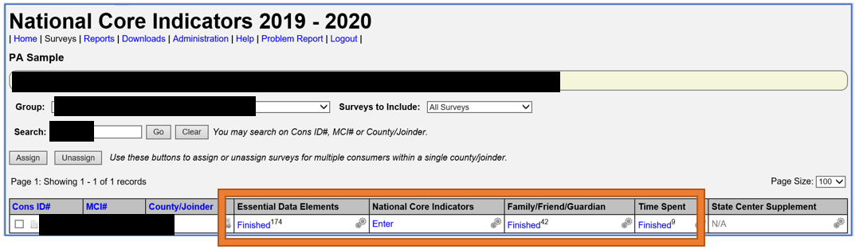
Enter AAW Pre-Survey and Survey results into ODESA.
Attach a file with a screen shot from ODESA once the survey is finished.
Attach the screen shot file to the next IM4Q Monthly Report.
BSASP IM4Q Regional Leads do not need to be copied on the monthly report emails.
Notes:
Local Programs should data enter the completed AAW Pre-Survey results into ODESA as this information is not able to be stored in HCSIS for AAW at this time. Once the surveys are completed, Local Programs will enter the data into ODESA.
Once a survey is marked as finished, the Local Program will take a screen shot and paste it into a document to attach to the next IM4Q monthly reporting form and submit to the associated AE and BCS Regional IM4Q Lead.
The BSASP IM4Q Regional Leads do not need to be copied on this email.

Slide 17
Local Programs must email the BSASP IM4Q Regional Leads to confirm the final status of the interviews.
Example
Sample Individual #1
1. Individual interviewed with considerations
Sample Individual #2
2. Individual interviewed without considerations
Sample Individual #3
3. Individual refused interview
Oversample
4. Individual interviewed without considerations
Oversample
5. Individual not needed; all three interviews complete
Notes:
Since the AAW IM4Q interviews are not entered into HCSIS and the BSASP IM4Q Regional Leads cannot pull the information from ODESA, BSASP relies on the Local Programs to contact the BSASP IM4Q Regional Leads once they've finished interviewing the AAW individuals on the sample.
For example, if a county was allocated three AAW Individuals, the final update to the BSASP IM4Q Regional Lead might look like this:
Individual interviewed with considerations
2. Individual interviewed without considerations
3. Individual refused interview
4. Individual interviewed without considerations
5. Individual not needed; all three interviews complete

Slide 18
BSASP IM4Q Regional Office Leads
Western BSASP IM4Q Regional Lead: Jennifer Farmerie jfarmerie@pa.gov
Supervisor: Heather Ruppe hruppe@pa.gov
Central BSASP IM4Q Regional Lead: Stephen Gensemer sgensemer@pa.gov
Supervisor: Anissa DeCapria-Sanduta adecapria-@pa.gov
Southeast and Northeast BSASP IM4Q Regional
Lead: Agnes Gimlewicz agimlewicz@pa.gov
Supervisor: Diane Jones dijones@pa.gov
Notes:
This is a list of the BSASP IM4Q Regional Leads as well as their supervisors.

Slide 19
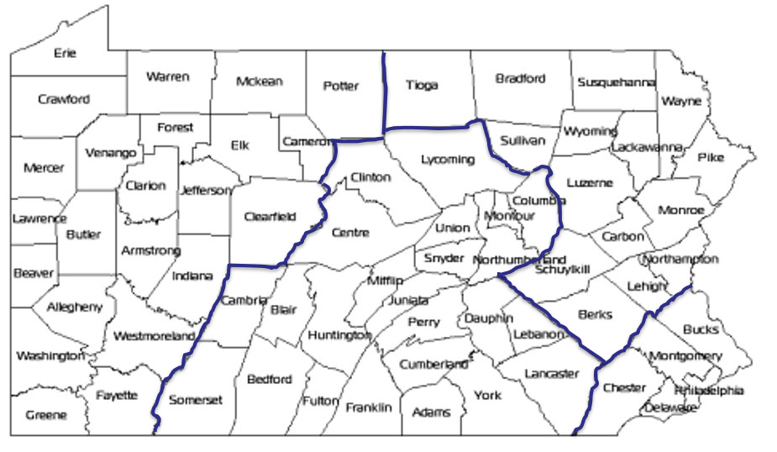
Regional Map
Northeast
Central
Western
Southeast

