Slide 1

ISAC, IM4Q and Racial Equity: Looking at What’s Important
July 2022
Notes:
Welcome to ISAC, IM4Q and Racial Equity: Looking at What's Important.
Today's presentation will include a brief description of who ISAC is, changes that are being made to ISAC performance measures, how IM4Q is used in connection with ISAC performance measures, and how both are working to promote racial equity.
I'm Tara Giberga and I will start us off and then I'll hand it over to my colleague Samer Abdelhadi to finish out the presentation.

Slide 2

ISAC: ODP’s Quality Council
Information Sharing & Advisory Committee
(ISAC)
2
Notes:
So, who or what is ISAC?
In November 2014, the Information Sharing and Advisory Committee (ISAC), which includes individuals with ID and family members of individuals with ID, was formed to serve as ODP’s stakeholder quality council with the purpose of discussing policies and practices and making recommendations. At that time, more than 265 stakeholders conducted research and evaluated best practices to prioritize the most important steps for ODP to take to improve system delivery. The ISAC went on to create a detailed series of recommendations, strategies, and performance measures to guide ODP and gauge progress in achieving the goals published in the 2016 edition of Everyday Lives: Values in Action. Detailed descriptions of each recommendation, along with strategies the ISAC agreed to work together to implement, as well as performance measures to monitor performance, are contained in a companion document called Everyday Lives Recommendations, Strategies, and Performance Measures. Annually, ODP produces and distributes a report to all ODP stakeholders detailing progress made toward achieving each recommendation. This report is reviewed thoroughly with ISAC and their feedback is collected and utilized accordingly.

Slide 3

ISAC Recommendation #9 – Improve Quality
Together we must plan and deliver services and supports
that adhere to our values, measure person-centered outcomes, and
continuously improve an individual’s quality of life.
All stakeholders must be engaged in the process of measuring how well services
assist people in achieving an everyday life.
Notes:
There are currently 14 ISAC recommendations, with #14 - Promote Racial Equity being added in 2020, in response to an emerging focus on racial equity issues. Samer, my co-presenter and ODP’s lead for recommendation #14, will present more on this recommendation and its connection with IM4Q a little later in this presentation.
One of the other ISAC recommendations, #9 – Improve Quality states ... (read slide)
So, what is quality?
In any industry, it is the people in the community who use the product/service that ultimately define what quality means to them, related to that product/service. So, to understand how satisfied people are with their lives, relative to the ODP service system—which provides insight into how they define quality—we ask them, using the IM4Q interview survey process, among other ways.
The IM4Q interview data collected each year is anonymously aggregated (put together) and shared in data reports used by ODP and its stakeholders for continuous quality improvement (CQI) activities. An IM4Q Steering Committee of ODP stakeholders identifies system improvement recommendations for action and submits them to ISAC. In collaboration with ISAC, ODP prioritizes opportunities for system improvements, and communicates these priorities to the field.​

Slide 4
ISAC Performance Measures & Updates
Based on feedback from ISAC during annual report review
Continued work to improve tools used to see how AEs, SCOs and Providers are doing
One main objective - shift some things we measure from "compliance focused" to "person-centered outcomes focused" (direct impact on people we serve)
Many ISAC performance measures are informed by IM4Q.
Notes:
As part of ODP’s continuous quality improvement activities, we continue to make improvements in several areas of our Quality Management strategy. This includes incorporation of feedback from ISAC's review of the annual report and making improvements to the tools we use to monitor how Administrative Entities (AEs), Supports Coordination Organizations (SCOs) and providers are doing (with complying with requirements and providing quality services).
Tool revision has included shifting some of the things that we measure from "compliance focused" to "person-centered outcomes focused," meaning outcomes that have a direct impact on the people we serve.
Because there are ISAC performance measures (PMs) that are informed (measured) by some of the questions asked in these monitoring tools, naturally this work expanded into the ISAC PMs, which also include measures informed (measured) by IM4Q data.
*Note that the presentation today will only be covering the ISAC PMs that are informed (measured) with IM4Q data AND are being revised to include a racial equity lens. A separate document entitled: ISAC PMs Measured by IM4Q has also been provided to you and includes all ISAC PMs measured by IM4Q, including the ones we will present today, in one document for your reference.
Now, I’ll hand you off to Samer.

Slide 5

ISAC Recommendation 14: Promote Racial Equity
Communities are richer, more just, and stronger when we honor and respect the whole of racial diversity. Access to a quality, person-centered, culturally competent system of supports and funding must be equally available regardless of race. Services must include planning over a life span and address racial disparities, including disparate outcomes. The duty to ensure that racial diversity is promoted and supported, at all levels within the services system, must be embraced.
Notes:
In 2020, ODP added a new recommendation: Rec#14 Promote Racial Equity
An ISAC subcommittee was formed from diverse group of stakeholders.
Three strategies were developed.

Slide 6
Develop Strategies
The Racial Equity Subcommittee
developed strategies for the new recommendation:
1. Consistently include breakdowns by race in data analysis and reporting and incorporate in QM plans.
2. Provide organizations with ways/framework to evaluate their own racial performance.
3. Support organizations with tools to improve racial equity performance and ensure increasing levels of racial diversity and inclusion, across all levels of the organization, as part of their quality management strategy.
Notes:
:

Slide 7

Strategy #1
“Consistently include breakdowns by race in data analysis and reporting and incorporate in QM plans.”
Notes:
The following slides focus on Strategy #1. We will review the proposed edits to ISAC performance measures with recommended changes highlighted in red...

Slide 8
Racial Equity Data Collection Activities
Embed racial equity data collection and analysis:
ISAC recommendation performance measured by IM4Q (Section 1)
IM4Q performance indicators and Racial Equity (Section 2)
Notes:
...and specifically those measured by IM4Q data. We'll also discuss plans for using IM4Q data to promote racial equity.

Slide 9

ISAC #1: Assure Effective Communication
For people who do not communicate effectively using words, the percent of people with a communication system in place, overall and by race, age, and living situation, i.e., a written plan in place that describes and documents a communication system, e.g., sign language, a picture board/system such as Picture Exchange Communication System (PECS), a voice-output communication device, or a combination of methods. A communication profile in the ISP is not sufficient in and of itself. (IM4Q)
For people with communication systems in place, the percent of individuals and self-advocates, overall and by race, who report using them across all settings (i.e., you use the system at home, at work, at school, and in your community). (IM4Q)

Slide 10


ISAC #2 & 4: Promote Self-Direction & Support Families
2. Promote Self-Direction, Choice & Control
Percent of individuals who reported they vote, overall and by race. (IM4Q)
Percent of individuals who said they were given a choice to live where people without disabilities live, overall and by race. (IM4Q)
4. Support Families Throughout the Lifespan
Percent of relatives, overall and by race, who reported the Supports Coordinator asks about their vision for an everyday life for their family member. (IM4Q)

Slide 11


ISAC #5 & 10: Promote Health & Community Living
5. Promote Health, Wellness and Safety
When asked how hard it is to get dental services in their community, percent of individuals, overall and by race, who reported it was very easy or easy, in-between, or very hard or hard. (IM4Q)
10. Expand Options for Community Living
Percent of people who like where they live, overall and by race. (IM4Q)

Slide 12

ISAC #11: Increase Community Participation ​
11: Increase Community Participation
Percent of respondents who say their relative has enough opportunities to participate in activities outside of where they live. (IM4Q)
Percent of respondents who say their relative has the opportunity to learn new things. (IM4Q)

Slide 13

SECTION 2: IM4Q PERFORMANCE INDICATORS
Exploring use of data through
establishing racial indicators from IM4Q
Notes:
Next, we will review how ODP is exploring use of data through establishing racial indicators from the IM4Q data already collected and reported in the IM4Q Annual Report.

Slide 14

IM4Q: Adding Racial Indicators to Existing Scales
Racial data indicators could be organized and included in these existing 7 scales (0 - 100) currently used in the IM4Q Annual Report.
SATISFACTION
DIGNITY
CHOICE
INCLUSION
PHYSICAL SETTING
FAMILY SATISFACTION
AFRAID
Notes:
IM4Q uses 7 scales as indicators of overall performance in different areas of interest—see slide.
Each scale is formed using a set of multiple questions. The results of these questions get calculated together to form one score between 0-100, the higher the score the better the performance.
The purpose of IM4Q scales is to help us understand how people feel about their lives and the services they receive, so that we can take action as needed. IM4Q scales allow decision makers at the state and county levels, as well as service providers, to engage in quality improvement at the program level (where individuals and families are receiving services) by highlighting low performing areas to prioritize and providing scales to measure progress on quality improvement activities over time.
The plan is to add a racial lens to the already existing IM4Q scales, so that we can not only measure the overall performance, but also performance as it relates to race.

Slide 15
IM4Q Scales: Satisfaction & Dignity
1. SATISFACTION
Higher score = Higher level of satisfaction
SATISFACTION Questions (6)
Like where you live
Live somewhere else
Like work/activities
Do something else
Lonely
Happy/sad
2. DIGNITY
Higher score = Staff and housemates treat them nicer
DIGNITY Questions (3)
Work/activity staff nice or mean
Home staff nice or mean
Housemates nice or mean
Notes:
Here are the first 2 IM4Q scales, Satisfaction and Dignity – review slide

Slide 16
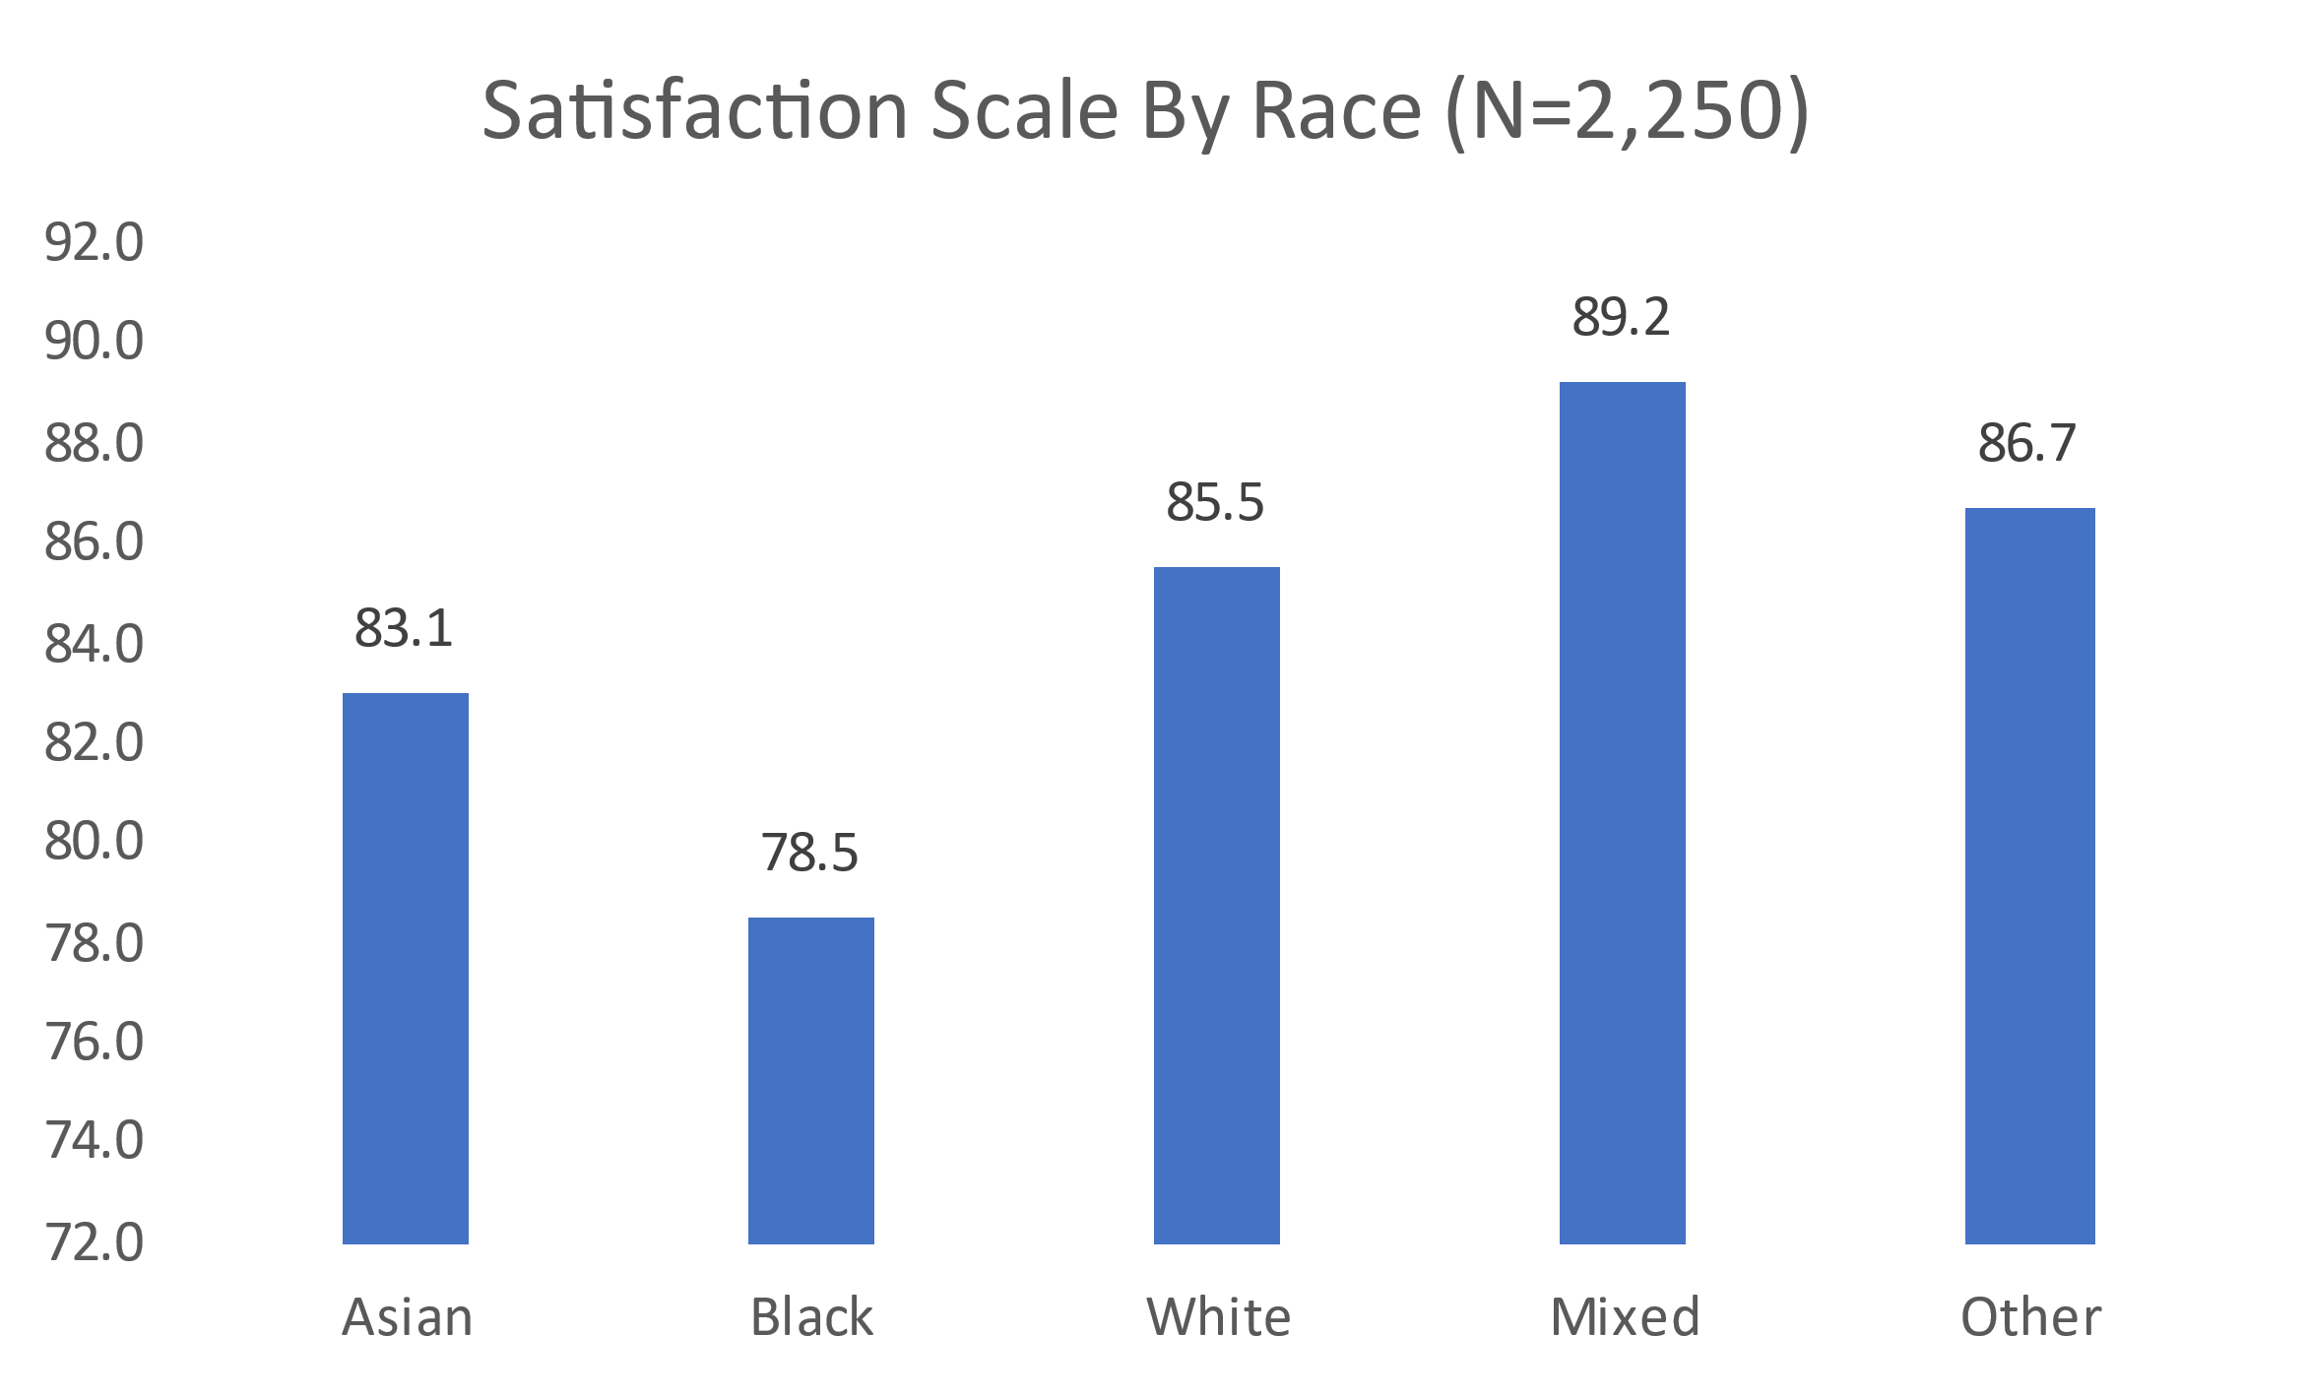
Satisfaction scale
Notes:
And here is an example of what adding the racial lens to the first scale, satisfaction, looks like.
Black individuals scored the lowest on the satisfaction scale with 78.5% compared to 83.1% satisfaction score for white individuals. Mixed races scored the highest on the same scale with 89.2%.

Slide 17
IM4Q Scales: Choice & Inclusion
3. CHOICE
Higher score means that individual has more choice and control.
Choice Questions (10)
Has a key
Chose home
Chose housemate
Chose work/activity
Chose schedule
Chose work/activity staff
Chose home staff
Chose what to do in free time
Chose what to buy
Chose SC
4. INCLUSION
Higher score means that individual has more frequent community participation.
Inclusion Questions (7)
Visits friends/neighbors
Go to supermarket
Go out to eat, Go to worship
Go to shopping center
Go to coffee shop/bar
Go to bank
Go out on errands
Notes:
Here are the next 2 IM4Q scales, Choice and Inclusion – review slide

Slide 18
IM4Q Scales: Physical Setting & Family Satisfaction
5. PHYSICAL SETTING
Higher score means that individual’s home is nicer.
Physical Setting Questions (3)
Home in safe neighborhood
Home in good repair outside
Home in good repair inside
6. FAMILY SATISFACTION
Higher score means higher level of satisfaction reported by the family.
Family Satisfaction Questions (8)
Like where relative lives
Like work/activities of relative
Like relative’s home staff
Like relative’s work/activity staff
Feels relative likes where they live
Feels relative likes work/activity
Feels relative likes home staff
Feels relative likes work/activity staff
Notes:
Here are the next 2 IM4Q scales, Physical Setting and Family Satisfaction – review slide

Slide 19
IM4Q Scales: Afraid
7. AFRAID
Higher score means that individual is less afraid.
Afraid Questions (3)
Afraid or scared when you are at home
Afraid or scared when you are out in your neighborhood
Afraid or scared when you are at work (paid or volunteer), school, or other community activities
Notes:
Lastly, here is the last IM4Q scale, Afraid – review slide

Slide 20

ODP Quality Management Division contacts
Tara Giberga
Quality Management
Division Director
tgiberga@pa.gov
Diana Ramirez
QM Coordinator dramirez@pa.gov
Samer Abdelhadi
QM Specialist
c-sabdelha@pa.gov
Deirdre Wright
QM Coordinator
deiwright@pa.gov
Notes:
We would like to thank everyone who attended today and encourage you to ask any questions you might have.
This slide includes contact emails for all QM Division team members. Feel free to reach out to any of us for any IM4Q quality management needs or questions.

