Slide 1

Expanding Options for Community Living
One Organization's Experience Offering the Housing Transition and Tenancy Sustaining Service
Tylin Colston
Leslie Lewis and Linda Ricketts
Marian Frattarola-Saulino

Slide 2
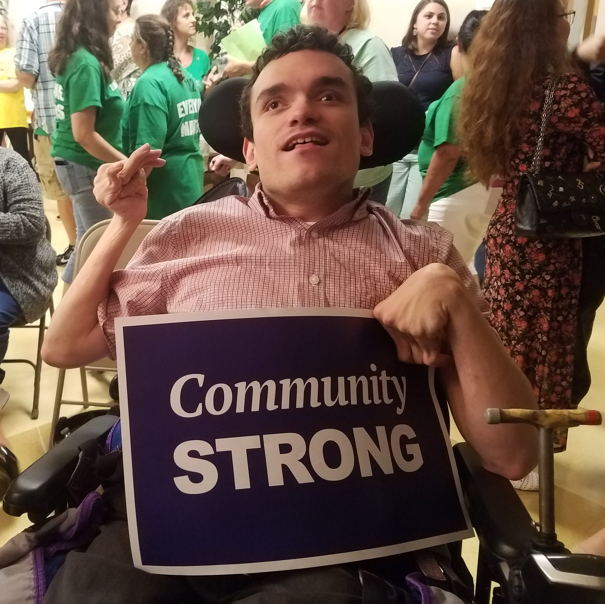
Nothing About Me Without Me!

Slide 3

Values Into Action
Notes:
MFS

Slide 4
What we were asked to do & What we did
To demonstrate a person-directed housing model that ensures people with developmental disabilities can control their own housing, choose where and with whom to live, and ensure that the housing is separate from their services.

Slide 5
Our Partners
Housing Developers, Experts and Professionals
Self Advocates
Family Members
Support Coordinators
Supports Brokers
Service Providers
Administrative Entities
Office of Developmental Programs Leadership Team
Pennsylvania Housing Finance Agency
Local Housing Authorities

Slide 6
Project Years One & Two
Establish and Meet with a Project Advisory Committee
Identify Individuals with a Developmental Disability Desiring to Take Control of their Housing
Individualized person-centered housing planning to participants
Develop and Conduct Housing Options Training
Provide Person-centered Housing Planning
Collaborate with current PADDC Advocacy Project and Person Directed Housing and Services Demonstrations

Slide 7
Project Year Three
Expanded Project Advisory Committee (PAC)
Conduct Housing Manual User Guide Trainings
Prepared Renters Education Program (PREP) training
Individualized person-centered housing planning to participants
Feedback surveys- throughout the project
Continued to Refine the Housing Manual User Guide

Slide 8
Project Year Four
PAC continues to meet and seek out new members from State Centers
Identify and Mentor Self Advocates to serve as paid advisors, trainers, facilitators for project activities.
4 virtual Housing webinars/trainings for key stakeholders
Identify 1-3 SCOs/AEs following the virtual trainings to participate in a demonstration of implementing use of the Housing Toolkit and the HTTS in their counties.
Taking Control of YOUR Housing Symposium

Slide 9
Project Year Five
Housing Advocacy Workgroup
Ensure the finalization of the Housing Transition and Tenancy Sustainability (HTTS) Training Curriculum
Pilot the curriculum to include Self-Advocates as trainers
HTTS training curriculum to PADDC and ODP for final recommendations
Informational forums on the HTTS Service and the training available for current and potential HTTS practicitioners and providers

Slide 10
System Change
What We Did:
Annual Service Limitation Increased
Indirect Support Allowed
Rate Increase
Qualification Revision Requested
What's Next:
Increase provision of the HTTS Service
Finalize HTTS Curriculum for provider certification as a qualification standard
Document further changes needed
HTTS Curriculum developed in partnership with ODP
Housing separate from service is the default

Slide 11
Meaningful Participation
What We Did:
Informed stakeholders about HTTS and Project during State Center Closure Hearings
People using HTTS speaking/sharing their experiences
Continued HTTS' participant feedback
ODP's ISAC formed a Housing Subcommittee to consider greater system impact
Project Advisory Committee chaired by a self- advocate
Housing Toolkit developed and available to all
Statewide Housing Symposium, open to all

Slide 12
Housing Challenges and Barriers Identified
Money/Resources
Limited availability of Housing Choice Vouchers
Lack of a livable income
Support
Barriers to obtaining the appropriate level of support
Limited or no family/natural supports
Housing Market
Limited availability of affordable homes

Slide 13

Impact
12 project participants
3 found housing of their own
9 began using HTTS
361 stakeholder educated through Information Sessions
105 providers attended pilot HTTS Training
46 people are currently supported through HTTS at Values Into Action

Slide 14
Finally Home Housing Toolkit User Guide
Instructions for using the tools to provide a structure for you to support a person with a disability to explore the many options of homes, places, and ways to live in their own home.

Slide 15
Housing Options Training Module 1
Guides you to explore housing options such as:
With whom do you want to live?
Where do you want to live?
In what kind of community or neighborhood?
In what kind of home?
What housing options might you consider?
An efficiency or studio apartment?
Would you prefer to own or rent your home?

Slide 16
Housing Options Training Module 2
Explores additional housing options, such as:
Basic housing characteristics (livability, habitability, accessibility, affordability)
Accessibility resources and assistive devices
How to make renting or buying a home affordable
Fair housing and reasonable accommodations

Slide 17
Housing Assessment
Assess
Assess the needs of the person seeking housing
Document
Document the preferences of the housing seeker
Assist in
Assist in the creation of the Housing Plan

Slide 18
Housing Plan
Summary of the housing goals obtained from the Housing Assessment.
Section A outlines the Action Steps for any housing seeker
Section B outlines the Action Steps for renting a home
Section C outlines the Action Steps for buying a home

Slide 19
The Appendix
Affordable Housing
Alternatives for Accessing and Expanding Housing Opportunities for People with Disabilities
Homeownership Housing Choice Voucher
Homeownership and Government Benefits
Housing Acronyms
HUD Minimum Habitability Standards
PA Housing Search
Tenant Selection and Waiting List Policies for Public Housing
Website Resources

Slide 20

Housing Transition & Tenancy Sustaining Service
Waiver service
Pre-tenancy and housing sustaining supports to assist participants in being successful tenants in private homes owned, rented or leased by the participants.

Slide 21
4 Major Roles
Conducting a tenant screening and Housing Assessment
Developing an individualized Housing Support Plan
Assisting with and/or identifying housing resources
Assisting with maintaining housing

Slide 22
Participant Eligibility
Individuals enrolled in the Person/Family Directed Supports (PFDS), Community Living or Consolidated waiver (Not available for persons on the Adult Autism Waiver)
Not available for participants authorized for residential habilitation, life sharing or supported living UNLESS:
A participant seeks to move from residential services to a private home
A participant in Supported Living needs assistance in identifying appropriate, sustainable housing

Slide 23
Team Expertise
Education
Interests
Drive
BS in Psychology
Tax Credit Specialist
Diversity & Inclusion
Equitable Housing Opportunities
Affordable Housing
“A slow yes, is better than a fast no.”
Experience
Connection
Homeless Coordinated Entry
Housing Choice Voucher Programs
Case Management
Transitional Housing
Personal Experience
Connection with shared experiences

Slide 24
Important Principles
Pre-Tenancy Supports
01
Person-Centered Planning
03
Everyone is the expert on their life – follow their lead!
We don’t know what we don’t know – start sharing!
Individual Housing Service Plans
Housing Sustaining Supports
02
04
We need to know about experiences, wants, needs and dislikes – so, ask!
We were able to meet one goal – onto the next one!

Slide 25
Considerations
Time
The average age range for moving out, independently,
for the first time is now
19 – 34 years old.
Understanding that, “Not Right Now,”
is not code for, “No”

Slide 26
Considerations 1
Options
Depending on the region, there are a minimum of 11 affordable housing programs available to housing seekers.
Sometimes to know what will work, you must learn what won’t work

Slide 27
Considerations 2
Desire vs Availability
As of May 2023, Pennsylvania had a 5.1% rental vacancy rate, which was lower than the national average of 6.4%.
Everyone deserves a home they love and can afford

Slide 28
Considerations 3
Affordability
As of January 2023, the median monthly rent for a one-bedroom apartment in Pennsylvania was $1,225.00.
Average Rent is rising but income is not

Slide 29
Considerations 4
Housemate Pairing
In the U.S., 31.9% of households are “doubled up.”
This means almost 79 million have a housemate of some sort.
Long lasting housemates rely heavily on compatibility

Slide 30

An Everyday Life in Action
Notes:
Play video

Slide 31
An Everyday Life- How Do We Get There?
Person-Centered Planning
Pre-Tenancy Supports
Interactive Meetings
Incorporate Leslie’s Activities
“What’s for Dinner?”
Separating Roles & Responsibilities
Smart Home Technology
Roommate Agreement
Emergency Planning
Staffing Home
Individual Housing Service Plans
Housing Sustaining Supports
Remaining in Childhood Home
Triple Transition
Team Integration
Creating Family Environment
Roommate Bonding
House Rules
Family Staffing
New Transitions
Notes:
When did they begin using HTTS service? 2021
How did I start working with the family?
What do I love about working with them?
Leslie’s spirit
Willingness for exploration
Openness to change

Slide 32
Everyone deserves a home.
Anyone can have a house.
Everyone deserves a home.

Slide 33

Questions?

Slide 34
Values Into Action
Marian Frattarola-Saulino, Executive Director marians@viapa.org
Tylin Colston, Housing Resources Specialist
tylinc@viapa.org
www.valuesintoaction.org
Facebook: ValuesIntoActionPANJ
Twitter: @Values2005
Instagram: ValuesIntoAction
LinkedIn: www.linkedin.com/company/values-into-action/

