Slide 1

Transitioning to Virtual Monitoring for Independent Monitoring for Quality in PA
2023 IM4Q Annual Statewide Training
July, 2023

Slide 2









The National
Leadership Consortium
Caitlin Bailey (She/Her), Co-Director
National Leadership Consortium
Cory Gilden (She/Her), Research & Evaluation Manager
National Leadership Consortium
Notes:
National Leadership Consortium on Developmental Disabilities was founded in 2006 and has facilitated more than 100 of our Leadership Institute training programs across the nation, with more than 3,000 graduates who are current and emerging leaders in the disabilities field. We aim to support the development and connection of leaders to have the skills, knowledge, values, and resources needed to impact organizational and systems change that is aligned with establishing the rights and self-determination of people with disabilities. To do this, our trainings focus on developing individual leadership and interpersonal leadership skills, organizational best practice and change management, current and future trends, best practices in services and supports.

Slide 3

External Evaluation of
Transition to Virtual Monitoring
July 2022
July-August 2022
Ongoing
Web-Based Survey
Monitor Interviews
Reporting
118 IM4Q Monitors and Program Coordinators
12 Interviews with IM4Q Monitors with Disabilities
Reporting of Results to IM4Q Staff and Other Audiences
Notes:
The National Leadership Consortium on Developmental Disabilities was funded by the Institute on Disabilities at Temple University to conduct an external evaluation to understand the transition from in-person to virtual IM4Q monitoring that will inform future training and accessibility for Monitors with disabilities. The mixed methods evaluation took place from June 2022 through August 2022. It consisted of two phases of data collection: 1) A survey of all Monitors and Program Coordinators, and 2) Interviews with 12 Monitors with disabilities.
The survey consisted of two tracks, one for Monitors and one for Program Coordinators and had about 30 questions, depending on how the participant answered. Survey questions related to three core focus areas: 1) Training and preparation, 2) Ongoing support, and 3) Overall experiences and recommendations. The survey contained multiple choice and short answer questions and was open to respondents from July 5th through August 6th, 2022. The survey link was sent to Program Coordinators at all Pennsylvania IM4Q programs who were asked to distribute the link to the Monitors in their programs.
For more in-depth descriptions of experiences and perspectives, we interviewed 12 monitors with disabilities who were recruited through the survey, which contained an option to give your email for an additional follow up interview. Program coordinators also helped with recruiting people to be interviewed. Interview questions reflected the same core focus areas of the survey and were open-ended.

Slide 4
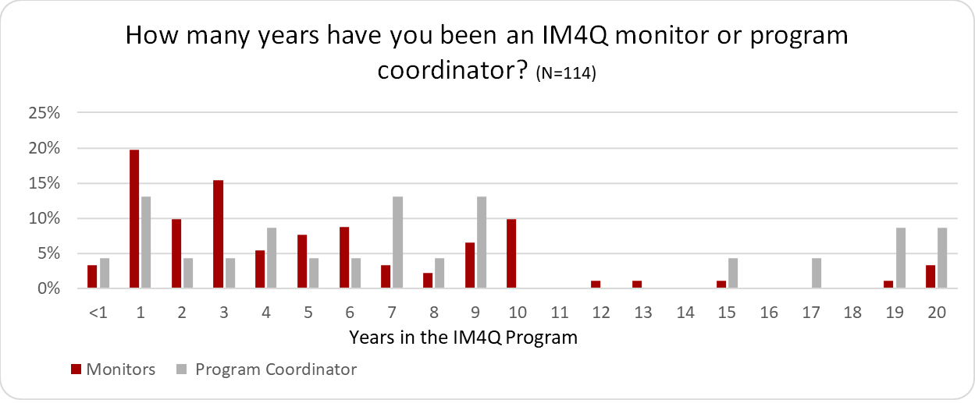
Participant Demographics
Has Disability | 22.0%
Has Family Member with Disability | 28.8%
No Disability or Family Member with Disability | 29.6%
Notes:
Survey participants were predominantly white (92.4%) and female (89.0%). The majority of participants were between 25-34 years old (13.56%), 35-54 years old (17.0%), and more than 65 years old (17.0%); 30% chose not to report their age. Nearly half of the participants (48.3%) had four years or less experience with the IM4Q program. Almost one-quarter (23.1%) of the Monitors had been an IM4Q Monitor for only one year, while 3% had done it for more than 20 years. Of the Program Coordinators who participated, three-quarters (72.7%) had joined the IM4Q program over the previous ten years, while 10% had been a Coordinator for 20 years.
Twelve Monitors with disabilities participated in the interviews. All interview participants identified as White, and two-thirds as female. Most Monitors interviewed were between 45 and 54 years old, representing 33.3% of the interview participants. While most Monitors identified as having more than one disability, half self-identified as having intellectual or cognitive disabilities. Two-fifths of the IM4Q programs in Pennsylvania were represented in the interviews, with Monitors from 8 out of the 20 IM4Q programs participating. One-quarter of the interviewees have been Monitors for four years, with one participant having more than 13 years of experience in the IM4Q program.

Slide 5
Training
Hours of Training
Notes:
How many hours of training did you get to transition from in-person to virtual interviewing?
Most of the participants (65.1%) received between two to five hours of training to transition from in-person to virtual interviewing, with one-third of those participants receiving 2-3 hours of training, one-third receiving 3-4 hours of training, and one-third receiving 4-5 hours of training. Six participants (7.2%) said they received more than 10 hours of training, while five (6%) reported receiving less than one hour. The majority of participants (83%) selected “Agree (Completely trained)” when asked if the amount of training they received overall (including NCI training) to transition from in-person to virtual interviewing was appropriate. About one-tenth of participants (11.7%) selected “Somewhat Agree (I needed a little more training),” while 1.1% (1 person) said they “Somewhat Disagree (I needed a lot more training),” and 4.3% (4 people) said they “Disagree (not at all trained).” Almost all participants (93.5%) agreed that they were trained in a way that was accessible to their communication, learning, and support needs.

Slide 6
Confidence
Average Rating Before Training:
6.5 out of 10
Average Rating After Training: 9.0 out of 10
Notes:
Positive experiences with training were reflected in Monitors’ 39.1% growth in confidence scores related to conducting virtual interviews before and after the training (see Figure 2). Participants were asked, “How confident did you feel conducting Zoom interviews before receiving training for virtual interviewing?” and “How confident did you feel conducting Zoom interviews after receiving training for virtual interviewing?” and given the opportunity to rate their confidence on a scale from 0 (Not at All Confident) to 10 (Extremely Confident). The average confidence score before training was 6.5 out of 10, and the average score after was 9.0 out of 10, reflecting a 2.5-point or 39.1% increase in confidence.

Slide 7
attentive
accessible
enjoyable
knowledgeable
excellent
professional
thorough
helpful
patient
hectic
supportive
informative
responsive
Very stressful
Notes:
How many hours of training did you get to transition from in-person to virtual interviewing?
Most of the participants (65.1%) received between two to five hours of training to transition from in-person to virtual interviewing, with one-third of those participants receiving 2-3 hours of training, one-third receiving 3-4 hours of training, and one-third receiving 4-5 hours of training. Six participants (7.2%) said they received more than 10 hours of training, while five (6%) reported receiving less than one hour. The majority of participants (83%) selected “Agree (Completely trained)” when asked if the amount of training they received overall (including NCI training) to transition from in-person to virtual interviewing was appropriate. About one-tenth of participants (11.7%) selected “Somewhat Agree (I needed a little more training),” while 1.1% (1 person) said they “Somewhat Disagree (I needed a lot more training),” and 4.3% (4 people) said they “Disagree (not at all trained).” Almost all participants (93.5%) agreed that they were trained in a way that was accessible to their communication, learning, and support needs.

Slide 8




Training Recommendations
 | Training | Tools, Developing Rapport Virtually, Different Interview Formats (In-Person/ Online, Group/ Individual)
 |  | For Monitor’s Support Person
 | Resources | Recorded Training, ‘Cheat Sheets’, Shadowing Opportunities
 | Role Play Scenarios | Strategies, Troubleshooting
 | Regular Meetings | Monthly Check Ins, Collaborate on Challenges and Successes
Notes:
Coordinators;78.3% respondedthat theycompletelytrainedMonitorson how to support theperson being interviewed to use Zoom, and 69.6%sharedthat theycompletely trainedMonitorsabout how to create a rapport withthe interviewee on a virtual platform.These results point totwo areas of trainingthat could be strengthened:how to supportpeople being interviewed to useZoom and how to create a rapport with people being interviewed virtually.
Figure3
Training ProvidedforTransitionto Virtual MonitoringIwastrainedhowto useZoomto conduct virtualinterviewsIwastrainedhowto support peoplebeinginterviewed howto use ZoomIwastrainedhowto create a rapport withpeopleIinterview virtuallyonZoomIwastrainedorgivenadvice onhowto makeaquiet,safe,andprivate placeforvirtual interviewsTrainingProvidedfor Transitionto Virtual MonitoringIM4Q Program Coordinator (n=23)IM4Q Monitor who is not a person with a disability or a family member of a person witha disability (n=35)IM4Q Monitor who is a family member of someone with a disability (n=34)IM4Q Monitor with a disability(n=26)Disagree Somewhat SomewhatLowest scoreshighlighted in yellow
Survey results showed thatrecommendationsprovidedbyMonitors without disabilitiesalsoincluded inviting Monitorsto attend statewide trainingsto benefit from the knowledgesharedat those eventsand offeringopportunitiesfornew Monitorsto shadow experienced Monitors during training.
On the survey, Program Coordinators were asked to describe whatthey diddifferently for trainingMonitors with disabilities. Their additional training methodsincluded:
•Recordingtrainings on Zoom to be used throughout the agency
•Providingopportunitiesto shadow otherMonitors
•Trainingon the specific tool questions and answers
•Providing“cheat sheets”on how to log in and additionalinformation
•Trainingon how to develop a rapport
•Training in different formats (group andindividual sessions)as needed
•Usingexamples and different scenarios to walk through troubleshooting
•Trainingthe Monitor’s support person as well
•Meetingmonthly to discusschallenges andsuccesses
6| Page
7 | P a g e
These methods were shown to be effective for Monitors in some programs and could be shared across the state and applied universally to future trainings.

Slide 9
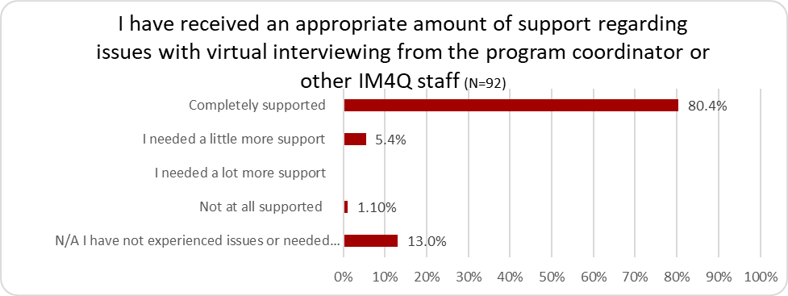
Support
Notes:
Overall, Monitors agreed that they were supported while conducting virtual interviews. Most of the Monitors (80.4%) stated they were completely supported by the Program Coordinator or other IM4Q staff when experiencing issues with virtual interviewing. However, five Monitors (5.4%) indicated they needed more support, while one (1.1%) did not feel at all supported. The remaining 12 Monitors (13%) reported not having needed additional support.

Slide 10





Support Recommendations
 | Extra Equipment | Headphones, Zoom Equipped iPads/ Tablets, Electronic Versions of Surveys
 | Check Ins and Guidance | Environmental Adaptations for Virtual Interviews, Accompany monitors during interviews
 | Space | Office space to hold virtual interviews
 | Coaching and Support | For monitors without disabilities to support monitors with disabilities
 | Troubleshooting Support | Sending Zoom Links, Checking Webcams and Audio
Notes:
About one-third (34.8%) of the Program Coordinators responding to the survey described supporting Monitors with disabilities differently during the transition to virtual interviewing than what was offered for in-person interviewing. Their additional support methods included:
Providing extra equipment, such as headphones and iPads/tablets
Providing guidance on environmental adaptations for ideal virtual interviews
Providing office space for virtual interviews
Providing coaching to Monitors without disabilities on how to support Monitors with disabilities
Setting up Zoom on iPads and tablets
Helping with troubleshooting (sending links to connect to Zoom, checking webcam, checking audio)
Participating in interviews in case support was needed during the interviews
Providing electronic versions of surveys
Increasing check-ins with Monitors with disabilities

Slide 11







Benefits to Virtual Monitoring
More Convenient
Requires Less Travel
Easier to Schedule
Safer
More Engaging
Enabled Monitors to Keep Working
Notes:
All groups of IM4Q Monitors, those with and without disabilities, named similar benefits of conducting interviews virtually when asked in the survey and interviews, including health safety, increased comfort, and the ability to schedule more interviews. However, Monitors with disabilities emphasized the benefits of the convenience, accessibility, and flexibility of virtual interviewing more. In contrast, other Monitors named the lack of transportation worries (i.e., less wear and tear on vehicles, no travel time, saving money on gas, no stress to find parking, no buses near location) as a top benefit of conducting interviews virtually. Many IM4Q Monitors with disabilities valued the convenience of virtual interviewing, liking that they were able to do the interviews from home without having to go out in bad weather, worry about finding someone’s house, or worry about how accessible it would be for them once they got there. Other benefits of virtual interviewing included: easier scheduling, increased safety, more engaged interviewees, and opportunities for Monitors to keep working throughout the pandemic.
Program Coordinators also named less travel as the top benefit of virtual interviews. They noted that having to travel less saved time, saved money for the program, and kept more interviews scheduled during bad weather. Less travel was also one of the reasons Program Coordinators reported that they were able to schedule more interviews when they were done virtually. Flexibility in schedules and being able to meet with people in different locations at the same time also reportedly contributed to being able to schedule more interviews virtually.
Program Coordinators also noted that virtual interviewing was more comfortable and convenient. The people with disabilities being interviewed did not have to worry about Monitors seeing into their homes or cleaning before visits; interviewees were more willing to meet with Monitors online. It was also more convenient for people living in family settings and easier for parents who worked during the day to participate in virtual interviews. The Monitors wasted less time on “no shows” and did not have to worry about accessibility, which allowed more people with disabilities to participate as Monitors when they did not face transportation and accessibility issues.

Slide 12
Benefits to Virtual Monitoring
“I did not have to worry about accessibility of the houses.”
– Monitor with a disability
“It is difficult to travel to interviews. With [COVID-19] it kept me safe not being around other individuals.”
– Monitor with a disability
“The Monitors could stay safe in their own homes and still participate in the IM4Q survey process, keeping them involved with this and still being able to make some money as well.” – Program Coordinator
Notes:
All groups of IM4Q Monitors, those with and without disabilities, named similar benefits of conducting interviews virtually when asked in the survey and interviews, including health safety, increased comfort, and the ability to schedule more interviews. However, Monitors with disabilities emphasized the benefits of the convenience, accessibility, and flexibility of virtual interviewing more. In contrast, other Monitors named the lack of transportation worries (i.e., less wear and tear on vehicles, no travel time, saving money on gas, no stress to find parking, no buses near location) as a top benefit of conducting interviews virtually. Many IM4Q Monitors with disabilities valued the convenience of virtual interviewing, liking that they were able to do the interviews from home without having to go out in bad weather, worry about finding someone’s house, or worry about how accessible it would be for them once they got there. Other benefits of virtual interviewing included: easier scheduling, increased safety, more engaged interviewees, and opportunities for Monitors to keep working throughout the pandemic.
Program Coordinators also named less travel as the top benefit of virtual interviews. They noted that having to travel less saved time, saved money for the program, and kept more interviews scheduled during bad weather. Less travel was also one of the reasons Program Coordinators reported that they were able to schedule more interviews when they were done virtually. Flexibility in schedules and being able to meet with people in different locations at the same time also reportedly contributed to being able to schedule more interviews virtually.
Program Coordinators also noted that virtual interviewing was more comfortable and convenient. The people with disabilities being interviewed did not have to worry about Monitors seeing into their homes or cleaning before visits; interviewees were more willing to meet with Monitors online. It was also more convenient for people living in family settings and easier for parents who worked during the day to participate in virtual interviews. The Monitors wasted less time on “no shows” and did not have to worry about accessibility, which allowed more people with disabilities to participate as Monitors when they did not face transportation and accessibility issues.

Slide 13





Challenges to Virtual Monitoring
Technical Issues
No Access to Physical Surroundings
Less Engagement
No Privacy
More No Shows
Notes:
Technical difficulties and inability to assess the physical environment and support staff of the person being interviewed were the top challenges reported about virtual interviewing, followed closely by the lack of engagement and difficulty building rapport with the interviewee.
Most comments in the survey and interviews related to challenges indicated some sort of technical issues, such as issues with Zoom (e.g., the interviewee not having access to Zoom, not having the correct link, not being able to log on, not knowing how to use the platform and its features, discomfort with Zoom, and difficulty having them download the app), internet issues (e.g., not able to connect, poor audio, getting cut off due to a poor connection, the screen freezing due to a poor connection), and not having the technology needed to participate (e.g., no internet access or no device with the ability to connect via the internet). The comments were filled with frustration that Monitors struggled to help with these issues on the interviewee’s end.
Not being physically present during the interview also posed problems for participants. Some of the questions during the IM4Q interviews required the interviewer to report data about the interviewee’s environment and staff; this was difficult to do via a Zoom call, and many Monitors mentioned the issue. Monitors also shared that because they could not see off-screen, they were not always sure who was in the room with the interviewee, and privacy could not be ensured. One Monitor with disabilities explained in an interview how she thought someone was off to the side and influencing the interviewee’s answers during one interview.
Virtual interviews were also reported to be less personal than in-person interviews, leading to less relationship building and trust and more no-shows. Some Monitors explained how engaging people on the other end of a Zoom call was harder, making the interviewee not as talkative or interactive as they would have been in person. Because the Zoom calls were less social, Monitors also found it more difficult to build a rapport with the interviewees. Further, because it was easier not to meet for a Zoom call than to ignore Monitors knocking at your door, some Monitors dealt with more no-shows than in-person interviews.
Coordinators also mentioned the lack of comfort interviewees and their support had with technology and how that negatively impacted the interviews. Specifically, they shared that many interviewees or their support staff did not feel comfortable using technological equipment even when offered, had Zoom fatigue, and struggled to use available equipment. Also, getting everyone on the screen was sometimes challenging on the virtual platform. Monitors could not tell who was in the room. Program Coordinators also mentioned that sometimes too many people on the Zoom call at once interfered with the interviews.
Program Coordinators also spoke about difficulty establishing a rapport between the Monitor and the person being interviewed. They noted that several Monitors struggled to maintain a person’s attention on Zoom, it was hard to read reactions, the Monitor with a disability may not be as easily understood through technology or be able to use as many non-verbal cues, and there was a general decrease in comfort for participants. Many Program Coordinators mentioned that it was easier for potential interviewees to cancel or not attend interviews

Slide 14
Challenges to Virtual Monitoring
“People are often more friendly in person, particularly parents and guardians. Parents and guardians are often wary of people asking questions of or about people with IDD. It’s harder to build trust virtually than it is in person.” – Monitor without a disability
“I think in the beginning of [COVID-19] and virtual monitoring, individuals were really uncomfortable and didn't want to do anything online. With support, guidance, training, patience, and time, they became more confident and saw that they could do virtual and most enjoyed it.”
– Program Coordinator

Slide 15
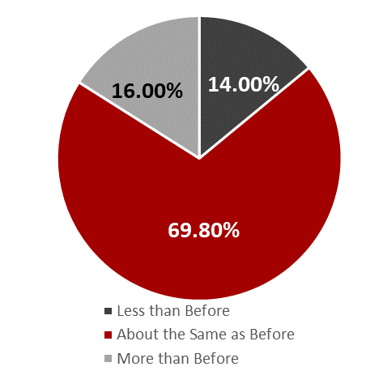
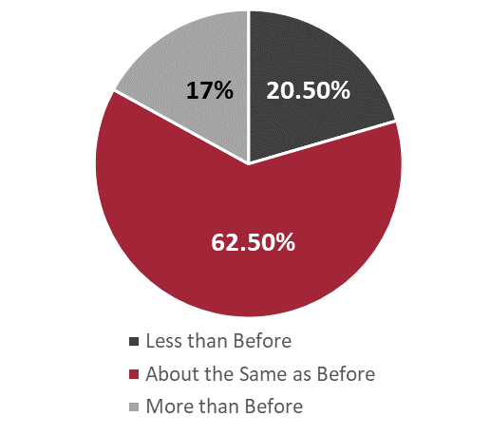
Quality of Virtual Monitoring
Monitor Success in Getting People Involved During Virtual Interviews (n=88)
Monitor Success in Gaining Information from Interviewees during Virtual Interviews (n=86)
Notes:
Implications for other researchers about virtual vs. in person
Results from interviews of Monitors with disabilities show mixed reviews as to whether the quality or amount of information provided was better or worse during the virtual interviews. Some Monitors identified issues with gathering information from interviewees. They shared interviewees could be hard to understand (and did not have a translator or someone supporting them with communication), difficult to engage with, or talked over by the person supporting them during the interview. However, some Monitors noted that these were also challenges they faced in the in-person interviews.
Some Monitors with disabilities shared that it was harder to build rapport and trust with people virtually, so people were more hesitant to offer personal information. They also shared concerns that people with less access to technology or data availability would be less likely to get involved in the interviews. Finally, a few people shared that some interviewees did not show up at the scheduled time, although they also said that was an issue with in-person interviews. These results are discussed further in the next section.

Slide 16
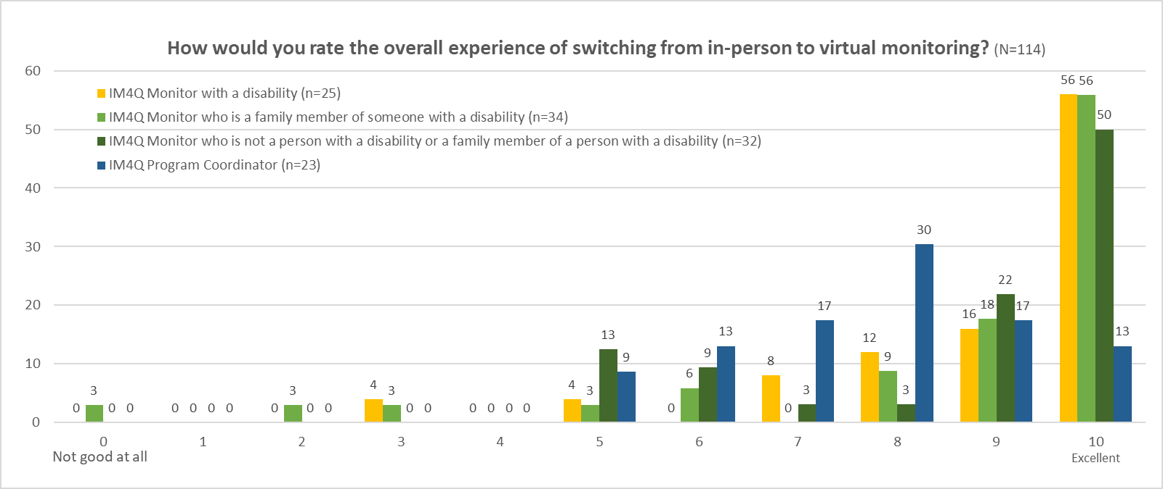
Overall Experience
Monitors with Disabilities: 8.9
Monitors Who Were Family Members: 8.5
Monitors without Disabilities: 8.6
Program
Coordinators: 7.7
Notes:
Monitors and Program Coordinators generally rated the transition to virtual monitoring positively. On average, Monitors with disabilities [in yellow] (8.9 out of 10), Monitors who were family members [in light green] (8.5 out of 10), and Monitors without disabilities [in dark green] (8.6 out of 10) rated the transition more positively than Program Coordinators [in dark blue] (7.74 out of 10). Figure Eight shows how each participating group rated their overall transition experience on a scale from 0 to 10, with high and low percentages displayed.
Results from the interviews may shed light on the differences between Monitors with disabilities and Program Coordinators. For example, several Monitors with disabilities shared that they preferred the virtual interviews because they were more accessible and less time-consuming than in-person interviews, which involved arranging transportation and potentially inaccessible interview spaces. These benefits and challenges are described further in the section below.
Many Monitors with disabilities also shared that their experiences with the transition to virtual interviews depended on their familiarity and comfort with technology (particularly the Zoom platform) and the support they received to arrange, conduct, and submit results from the interviews. People who were more familiar with Zoom, or had the support they needed, tended to describe the transition as smoother. However, when Monitors with disabilities felt they did not have the support they needed to access and use Zoom or troubleshoot technical issues during the interview, they described the transition as less successful. These results will also be discussed further in the Benefits and Challenges of Virtual Interviewing section of this report.

Slide 17





Overall Recommendations
Personalized support and training
Multi-formatted training and ongoing support
Tangible training and reference materials
Ongoing support and training
Invite support staff to training
Notes:
Participants had many recommendations about how to help support monitors with disabilities in their roles.
Many of these strategies can be implanted in other settings to best support people with disabilities (and those without) in all competitive employment positions.
Personalized support and training—discuss with the employee how they learn best and what they need to be successful
Multi-formatted training and ongoing support—offer in-person/online, one time/multiple, lecture/interactive/roleplaying, one on one/group, etc.
Tangible training and reference materials—cheat sheets, written reference materials and guidebooks, videos
Ongoing support and training—periodic check ins with employees, refresher trainings, opportunities to ask questions and give feedback
Invite support staff to training—make sure the people supporting the person with disabilities can be a reference and support as well; they may also have advice on how to best support that person

Slide 18
Comments? Questions?
Cory Gilden cgilden@natleadership.org
Caitlin Bailey cbailey@natleadership.org

