Slide 1

The Values and Principles that Direct Helping People Have the “Good Life”
Dr. Guy Caruso & Shawn Aleong
Institute on Disabilities at Temple University
guy@temple.edu & shawn.aleong@temple.edu
(724) 272-6162 (215) 805-0076
IM4Q AST 2023
This Photo by Unknown Author is licensed under CC BY-SA-NC

Slide 2

What are the Barriers?
Continued isolation and exclusion
Existence of segregated settings
Denial of individual support needs
Commodification of needs
Medicalization of needs
Misperceptions and stereotypes (Devalued Roles)
Lack of valued social roles
Devaluation and Wounding of People is the Enemy
Question – What barriers have you experienced?

Slide 3
Values and Principles Directing Having a Good Life
*Everyday Lives* (1991, 2016, 2021)
*Self Determination
*Being Person Centered
*Valued Roles
We need to understand and embrace values/principles that help people have a “good life”, as well as be Citizens (not second class) or just human service clients.
*Everyday Lives: Values in Action, 2021. Pennsylvania Department of Human Services,
Office of Developmental Programs

Slide 4
Everyday Lives: Values in Action
The foundation of 2021 Everyday Lives: Values In Action is two statements:
1. We value what is important to people with disabilities and their families, who are striving for an everyday life.
2. People with disabilities have a right to an everyday life; a life that is no different than that of all other citizens.
Everyday Lives: Values in Action (2021)is a guide to the Office of Developmental Programs (ODP) as it develops policy and designs programs.
Notes:
An everyday life is about opportunities, relationships, rights, and responsibilities. It is about being a member of the community, having a valued role, making a contribution to society, and having one’s rights as a citizen fully respected. It is a vision that we should all be working toward together.
This continues to be the truest statement on which we can build our work.
Everyday Lives will be a guide to ODP as it develops policy and designs programs. Providers of services will use the recommendations of Everyday Lives to support individuals and their families to achieve an everyday life. Everyday Lives will guide everyone toward the possibility of an everyday life.

Slide 5
DEPUTY SECRETARY’S MESSAGE
As we near the 30th anniversary of the adoption of Everyday Lives, the words of John McKnight included in the first Everyday Lives publication (1991) hold true: “Our goal should be clear. We are seeking nothing less than a life surrounded by the richness and diversity of community. A collective life. A common life. An everyday life. A powerful life that gains its joy from the creativity and connectedness that comes when we join in association as citizens to create an inclusive world.”
Everyday Lives guides us in our commitment to help create a world that embraces and celebrates human differences, a world in which everyone can experience belonging.
Kristin Ahrens, Deputy Secretary, Office of Developmental Programs

Slide 6
2021 EVERYDAY LIVES in ACTION – WHAT IS IMPORTANT TO PEOPLE WITH DISABILITIES www.myodp.org
EVERYDAY LIVES IN ACTION:
MY LIFE, MY WAY
*Control
*Choice
*Freedom
*Stability
*Health & Safety
*Connected
*Responsibility
*Communication
Question: What Does EDL mean
to you? Ask Audience
*Success
*Employment/Meaningful Contribution
*Individuality
*Relationships
*Partnership
*Quality
*Advocacy

Slide 7
2021 Everyday Lives in Action: What Families Value www.myodp.org
*Unique Role of Family
*Support throughout the
Lifespan
*Knowledge/Resources
*Mentoring
*Communication
*Respect & Trust
*Choice & Control
*Health & Safety
*Simplicity & Flexibility
*Quality & Stability
*Collaboration
*Opportunity for
Innovation

Slide 8
ISAC VALUES IN ACTION: RECOMMENDATIONS (Information Sharing and Advisory Committee)
ASSURE EFFECTIVE COMMUNICATION
PROMOTE SELF-DIRECTION, CHOICE, & CONTROL
INCREASE EMPLOYMENT
SUPPORT FAMILIES THROUGHOUT THE LIFESPAN
PROMOTE HEALTH, WELLNESS, AND SAFETY
SUPPORT PEOPLE WITH COMPLEX NEEDS
DEVELOP AND SUPPORT QUALIFIED STAFF
8. SIMPLIFY THE SYSTEM
9. IMPROVE QUALITY
10. EXPAND OPTIONS FOR
COMMUNITY LIVING
11. INCREASE COMMUNITY
PARTICIPATION
12. PROVIDE COMMUNITY
SERVICES TO EVERYONE
13. EVALUATE FUTURE
INNOVATIONS BASED ON
EVERYDAY LIVES PRINCIPLES
14. PROMOTE RACIAL EQUITY
Question: Speak to #14.

Slide 9

Guiding Principles of Self Determination
*CHOICE
*RELATIONSHIP
*CONTRIBUTION & COMMUNITY
*ROLES & RESPONSIBILITIES
*CONTROL
*DREAMS
*DIGNITY & RESPECT
*FISCAL CONSERVATISM
*ATTITUDE
Question: What Does Self Determination Mean to You?
This Photo by Unknown Author is licensed under CC BY-SA

Slide 10
Some Basic Assumptions for Person-Centered Approaches
Everyone has contributions to make
Everyone has gifts and capacities
Everyone is unique
Everyone needs supports
Blessing Consulting Group 2006
Question: What are some of your gifts?

Slide 11
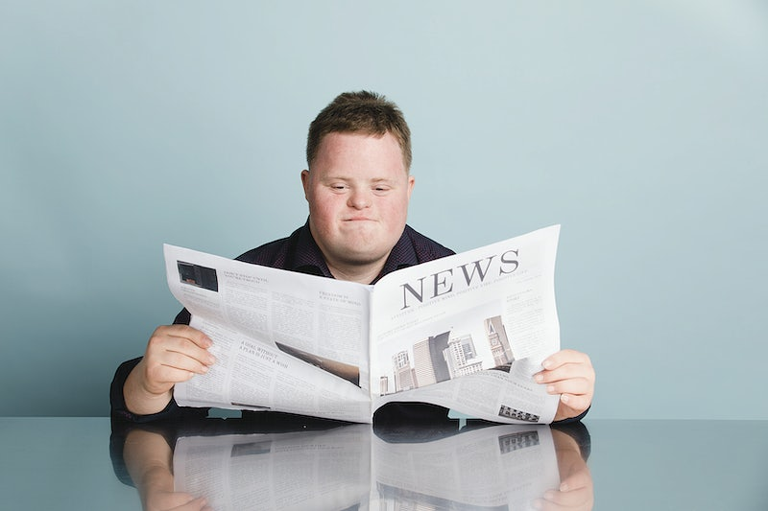
Basic Elements of Person-Centered Processes
Positive Profile of the Person
Inclusion of Significant Others
Capacity Focus
Contribution & Citizenship
Natural Communities
Network of Support
Realignment of Traditional Structures
Blessing Consulting Group 2006
Question: Tell us About Your Person-Centered Experience?

Slide 12
From Normalization to Social Role Valorization (SRV) Wolf Wolfensberger - 1970’s to Now
*Normalization – Presence in Community
*Wolfensberger – Presence is NOT Enough
*Devaluation Still Exists and is the Enemy
*Combat Devaluation and Devalued Roles
*Social Role Valorization (Valued Roles)

Slide 13
Devalued Roles – Can Have More Than One
Non or subhuman (vegetable/object), alien
Menace
Waste, Garbage, Discard
Ridicule
Pity
Charity
Child – a. Eternal b. Once Again
Sick/Diseased
Dying, or Already Dead
AVOID AT ALL COSTS
Question – What Role(s) Have You Been Caste Into?

Slide 14

A Brief Definition of Social Role Valorization (SRV)
The Pursuit of the Good Things in Life For
People Via The Pursuit of Valued Social
Roles For Them

Slide 15
The “Good Things of Life” For Most People
Good Health
Security, Safety, Protection
A Home
Friends, Family, Loved Ones
Belonging in an Intimate Group
Acceptance, Welcoming
Not Being See as Odd, Strange
Having a Say
Freedom of Movement
Access to Everyday Places in Community
Being Treated as an Individual
Opportunities & Expectations to Discover & Develop One’s Talents
Having Something Important to Contribute & One’s Contribution Acknowledged
Valued & Remunerative Work
Access to Valued Occupations
Fair & Just Treatment
Respect
Being Dealt With Honestly
Transcendent Belief System

Slide 16
Valued Role Areas of Life:
1. Home & Neighborhood
2. Family & Friends
3. Work
4. Learning
5. Spiritual & Religious
6. Community Association
7. Sports & Fitness
8. Creative Expression
Question: What are your valued roles?

Slide 17
Key Principles – Raise Your Consciousness
*Citizenship NOT Client-hood
*Culturally Valued Analogue (CVA) – What would
persons who are valued do (no less)
*Age-Appropriate (NOT Mental Age)
*Valued NOT Devalued Roles
*High Expectations
*Positive NOT Negative Image Enhancement
*Competence and Skills Enhancement
*Friendship &Relationships with Valued Others

Slide 18
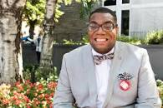
Last Words & Ending Comments
Temple student Shawn Aleong named to President Biden’s Committee for People with Intellectual Disabilities

