Slide 1


A stroll around

Slide 2
On January 23, 2023, MyODP was updated with a new navigation structure with the incorporation of home.MyODP.org. This new navigation structure allows resource pages to be accessed without an account, making information more accessible to the public and expands Training navigation to allow professionals to find suitable Trainings appropriate to their role.
Many resource pages were also combined to allow for more information to be found on one page, with shorter pathways to locate them.
A MyLearning page was added to allow professionals to access recent courses, course search, grades, transcript, and bookings on one page.

Slide 3
we now have over 180,000 registered accounts
9,000 Active users weekly
29,000 Active users monthly
78% of users use a desktop device
Over 875,000 pageviews a month
67,000 unique sessions per month with 13 pages accessed per session
67% of people that access the site are new visitors
197,000 unique certificates issued in FY21/22
104,000 of those were DSPs, 15,000 were SCs, 4,500 were AEs

Slide 4
The MyODP help desk answers tickets over e-mail, phone, and chat
Average 90 tickets per day
Average 92 tickets solved per day
Average 220 agent touches per day
Average 11 calls per day
Average 11 chats per day
Average 70 emails per day
Notes:
Service Level Agreements highlights:
Problem Circumvention or Resolution Time
1-Urgent Priority within 2 hours
2-High Priority within 1 calendar day
3-Standard Priority within 1 week
4-Low Priority within 1 month
Timeliness of Availability
90% or higher
Solution Support Availability
95% availability during core hours
Support response time
Within 30 minutes during core hours

Slide 5
What makes up MyODP?
Moodle
Used to host our online trainings
WordPress
Used to host our online resources
Amazon AWS S3 Repository
The majority of documents and video files are posted on Amazon AWS S3 Repository and then linked through Moodle
MyODP Connect
HTML5 webcasts
Notes:
The majority of documents and webcasts are posted in an Amazon S3 repository. Training contractors have access to the repository to post their webcasts and documents to link inside their courses. It is generally best practice for documents to be placed in the repository instead of being uploaded directly in Moodle.
MyODP Connect is our Adobe Connect site which hosts are interactive Flash and HTML5 webcasts. We are currently looking into the best methods for converting the Flash webcasts to HTML5.

Slide 6
Accessibility
All content on MyODP needs to be as accessible as possible and meet ADA standards
MyODP has accessibility options for text (contrast, size, readspeaker)
Proper headings and identifiers in html/css coding
Webcasts need at least to have a copy of the PowerPoint which can be read with a screen reader
Notes:
When thinking about navigation, content, and page design on MyODP, accessibility is one of our top priorities. We do have users that may be hard of hearing or have physical or visual impairments who rely on screen readers or keyboard navigation.
Simplified language should also be used where possible.
Built into the site is contrast buttons, text sizing buttons, and ReadSpeaker, which are available on every page of the website.
Moodle automatically assigns headings for course pages when using topic boxes, however course creators should be aware that variations to the normal Moodle format needs to assign headings appropriately. Site pages will always need to have headings entered manually. Images will always need alternative text.
While we prefer that webcasts have some sort of captioning, at a minimum the transcript needs to be available in pdf format along with the webcast.
There are some exceptions for accessibility due to the type of training for professionals

Slide 7
Home
home.MyODP.org is the new home page for MyODP materials
Recent news are updated automatically on the main page
Includes an introduction to our office, highlighted reports, and links to subscribe to ODP listservs
Notes:
All banners have accessible text and link to another page.
Users who are logged in are able to download the certificates they have received on the home page, and are able to run a report containing their transcripts
Other custom reports are available to Admins and Managers on the Home page

Slide 8
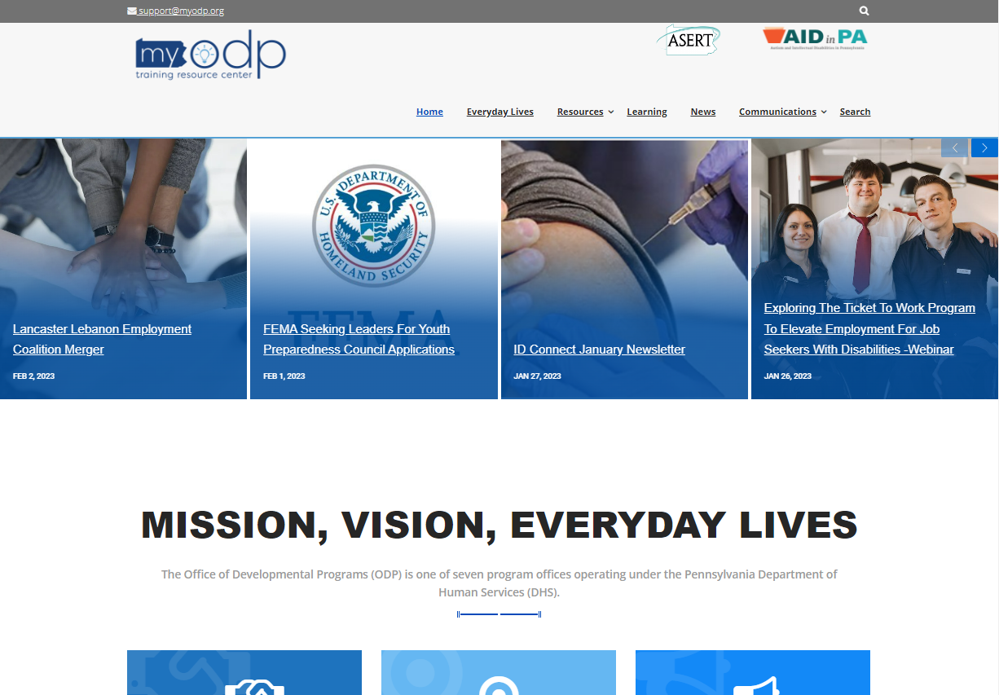
Links to ASERT and AIDinPA
Recent MyODP News stories display here
Displays our Mission, Vision, & Everyday Lives, stats, reports, and links to subscribe to ODP Listservs

Slide 9
Everyday Lives
This section features the values that guide the Office of Developmental Programs and highlights stories about Pennsylvanians with disabilities.
This page currently consists of 6 different links
A section which houses Everyday Lives publications, including the Everyday Lives: Values in Action booklet
The 2016 Everyday Lives Webinar which was presented by Former Deputy Secretary Nancy Thaler
The Provider Profiles webpage as a resource for Individuals and Families
A recap of the 2018 ‘Everyday Lives Conference’ and will provide updates on future conferences
The ‘Story Spotlight’ which features an article of a story or situation of people living Everyday Lives
An abstract of the LifeCourse Framework and Community of Practice along with contact information in ‘Envisioning an Everyday Life’
Notes:
The Everyday Lives page is a site page which is available to all visitors whether they are logged in or not.

Slide 10
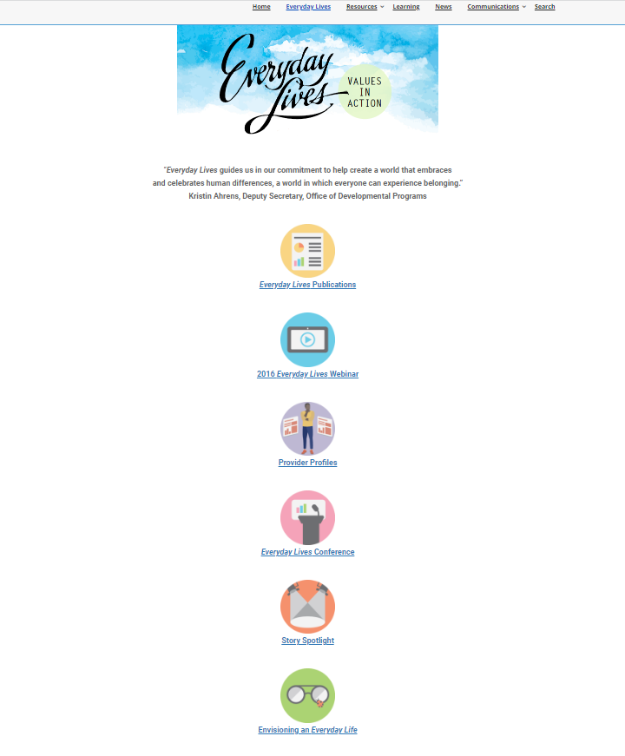
Contains PDF versions of the Everyday Lives booklet and recommendations
Along with the webinar, there is also an option to download the PowerPoint & transcript
Page to assist individuals and families with researching Providers
Conference info is updated here
Stories are posted here and past stories may be accessed in the story archive
Information on the Community of Practice is posted here

Slide 11
Resources
Resources are now consolidated in fewer separate pages on home.MyODP.org
No login is required
Each page will have unique images
Documents and videos will have a preview icon for each file
Follow a similar path to the old Resources tab.
Notes:
The Resources tab will soon be labeled the Topics tab. The Topics tab will contain dropdowns of specific topic areas. Each topic area will link to a page which has all relevant information related to that topic.

Slide 12
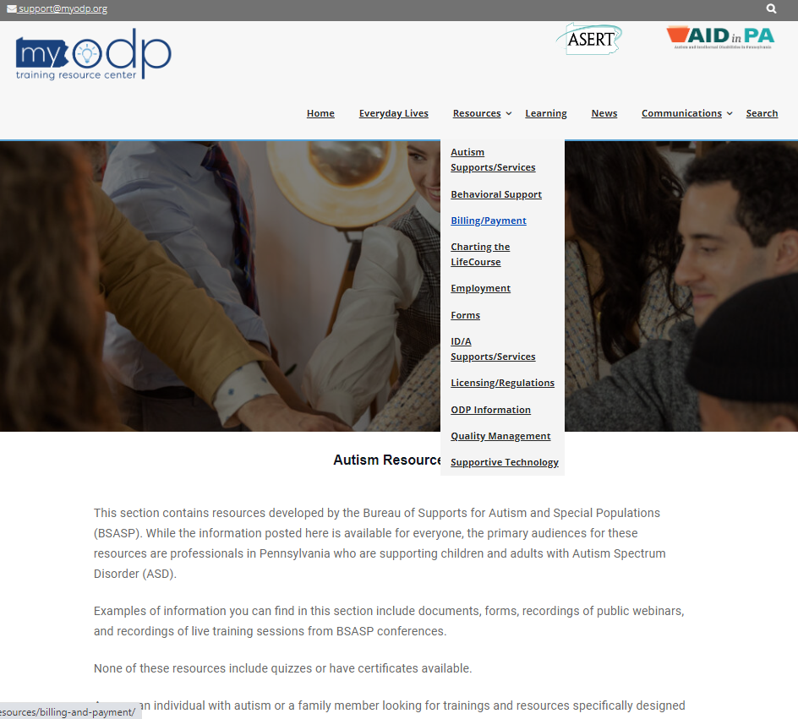

Slide 13
Supportive Technology
Hosts the Technology Today newsletter, Technology corner, and recent presentations
Quality Management
Information on ODP’s Quality Management Strategy including the QM Bulletin and QM Planning and Implementation Documents.
Employment
Information and resources related to employment targeted to various audiences
Charting the LifeCourse
Contains description of the Community of Practice, Innovation Areas, Regional Collaboratives with info for each county, and Charting the LifeCourse materials

Slide 14
MyODP News Online
This section contains regularly posted news stories on timely topics, sorted by Policy, COVID-19, Events, and Tools & Guidance
The Communication Corner is also available on this page
Notes:
The Training tab will soon be labeled the Professionals tab, and will contain dropdowns of different professional roles. Each dropdown will link to a page which contains all relevant information for each professional.

Slide 15
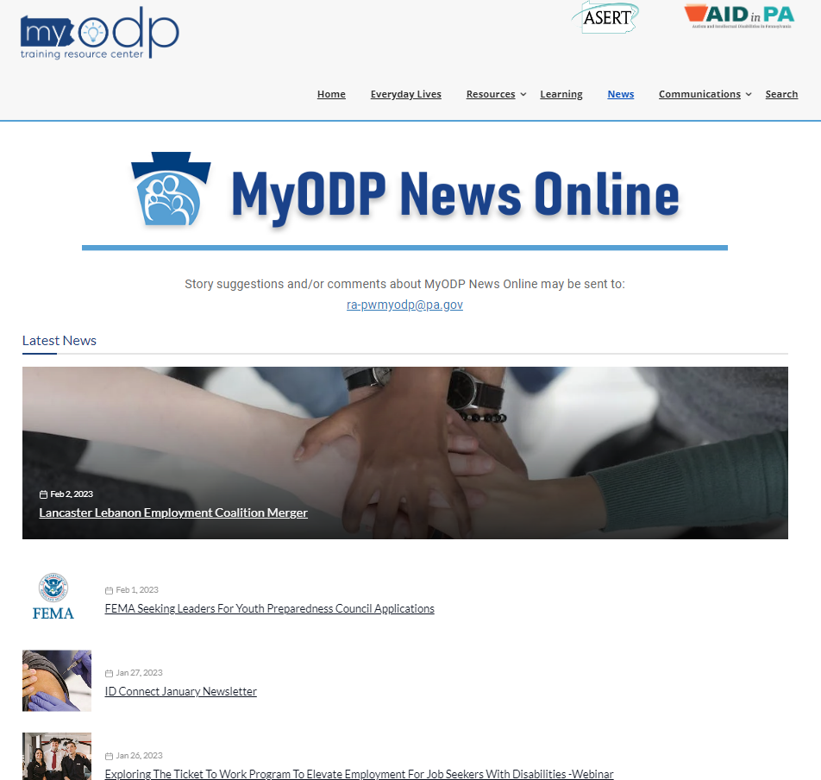
Notes:
The Training tab will soon be labeled the Professionals tab, and will contain dropdowns of different professional roles. Each dropdown will link to a page which contains all relevant information for each professional.

Slide 16
Communications
Will be transferred to home.MyODP.org within the next few months. They link to their current location on MyODP. Under this tab you can find:
ODP Announcements
Positive Approaches Journal
Upcoming Events
Notes:
The Communications page is built by using the Moodle database activity

Slide 17
Announcements
Weekly Digest announcements are sent to all MyODP users
Users can unsubscribe from notifications by clicking Manage your subscriptions at the top of the Communications database page
Will soon be available with a streamlined interface on home.MyODP.org

Slide 18
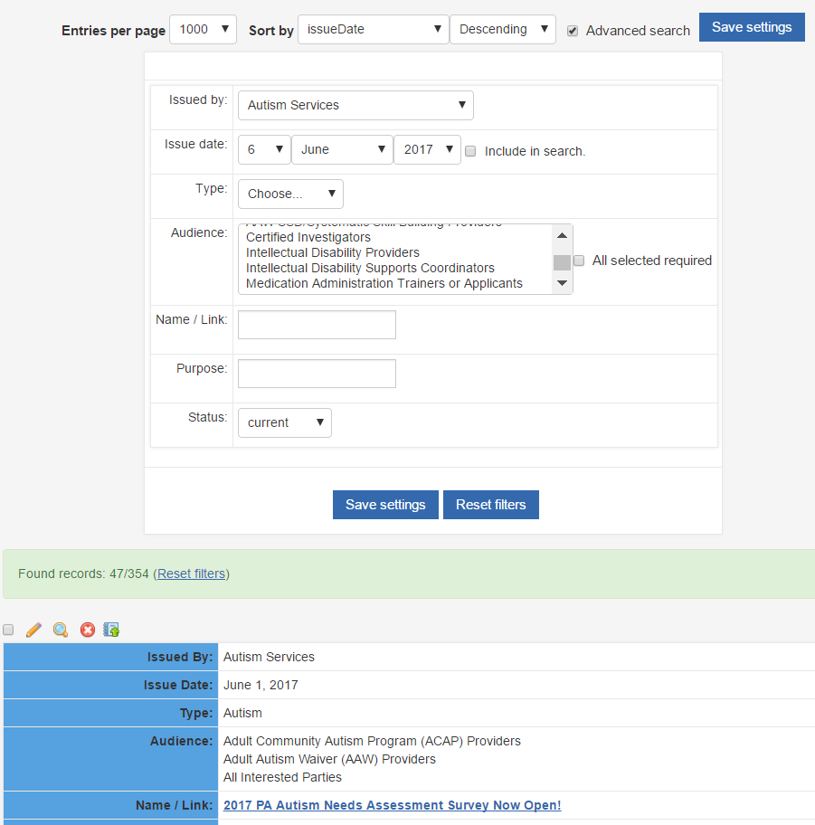
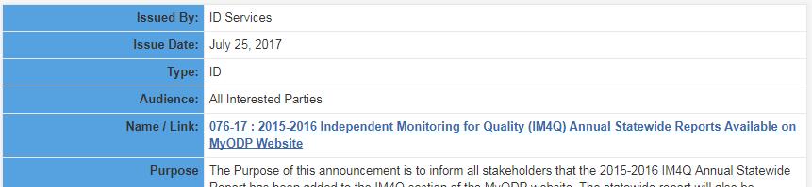
Choosing an audience and selecting ‘Save Settings’ will filter all communications
‘Purpose’ will only yield results in the ‘Purpose’ field for communications
Searching keywords in ‘Name/Link’ will only yield results in the ‘Name/Link’ field for communications
Selecting the ‘Name/Link’ will open a PDF with the full communication

Slide 19
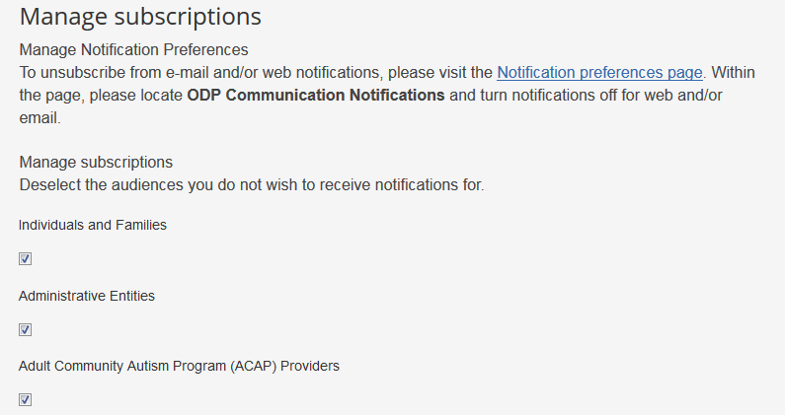

Users can select audiences they wish to subscribe to
Users can turn off Notifications on the Notifications preferences page

Slide 20
Positive Approaches Journal
Feature resources, observations, and advancements that are relevant and timely to professionals and supporters.
Issues released quarterly

Slide 21
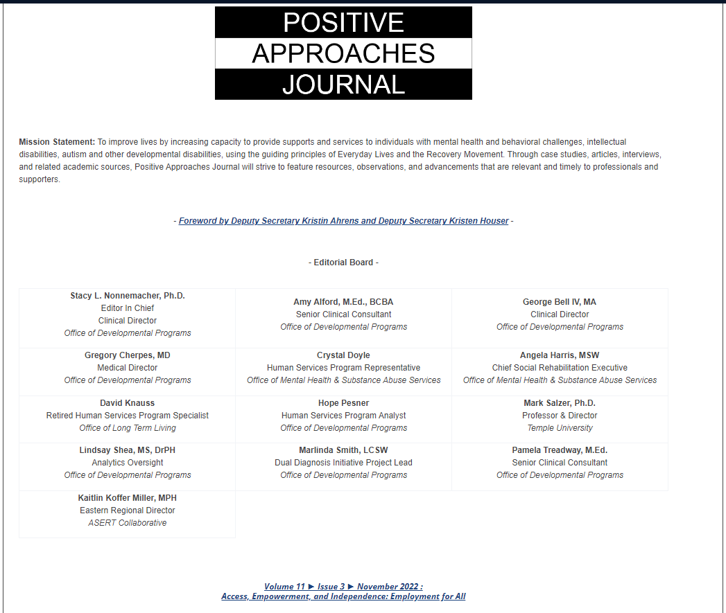

Slide 22
Upcoming Events
This section contains information about upcoming events hosted by ODP.
ODP sponsored trainings and conferences are featured here
Upcoming events are displayed on the side of most pages
Notes:
The Upcoming Events page makes us of the Moodle Calendar. Trainers are also able to add course events which only show up for students of that course. Users can also add their own events which only show up for them.

Slide 23
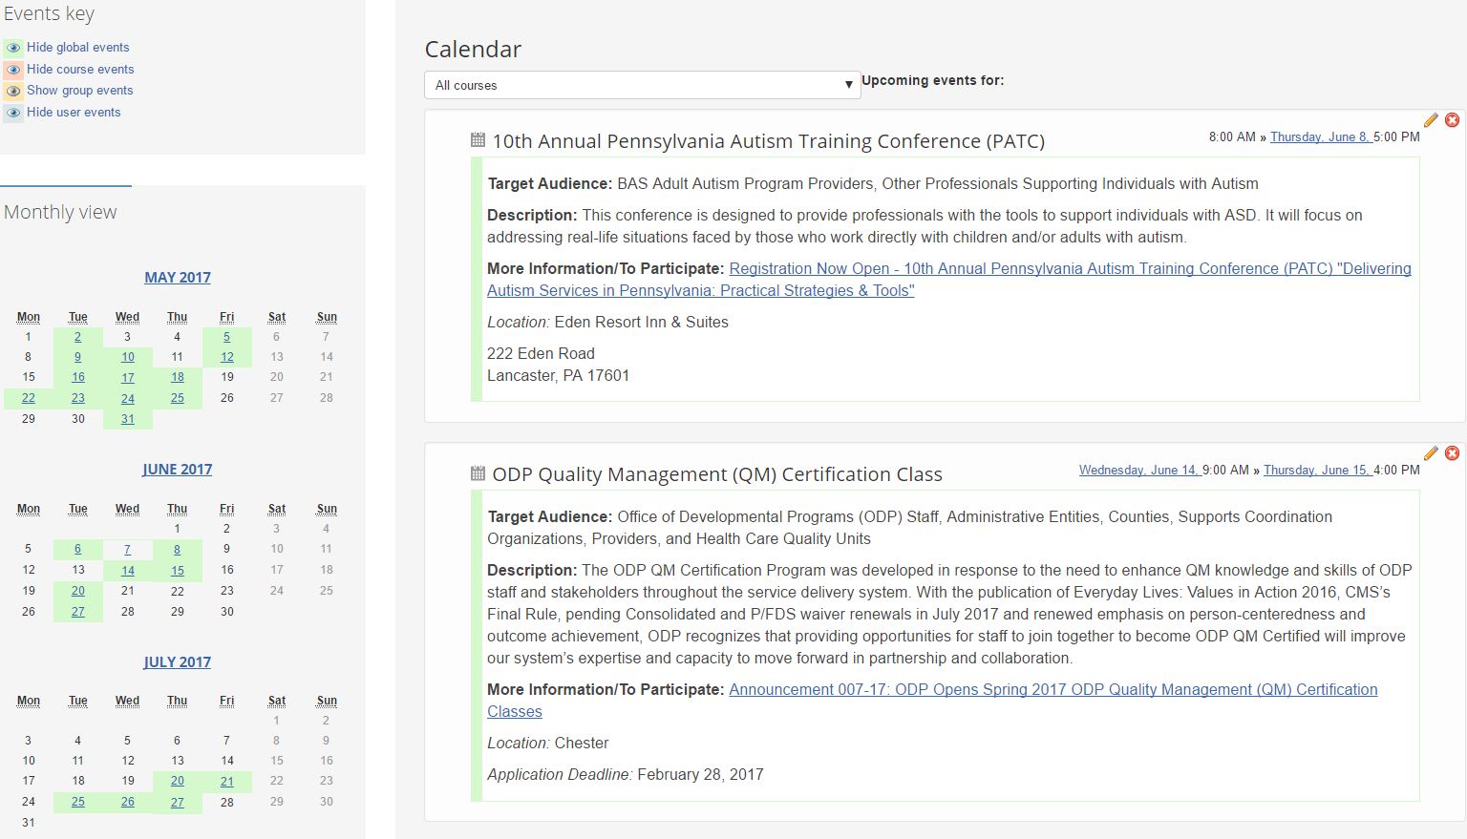
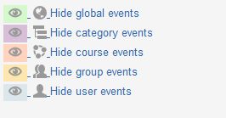
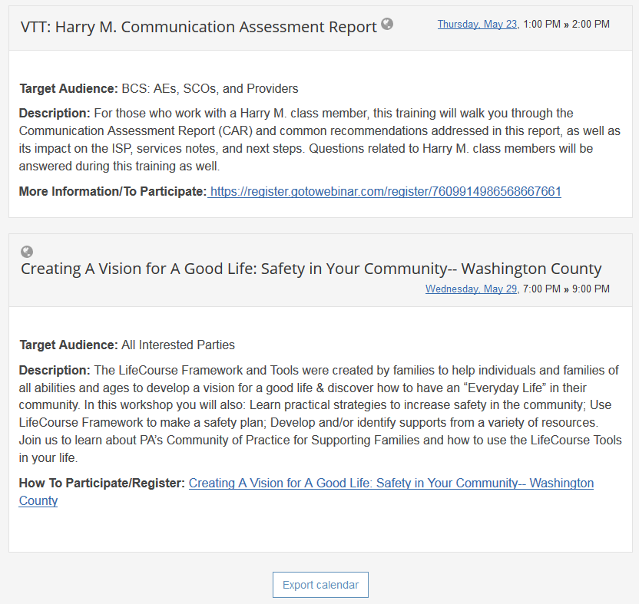
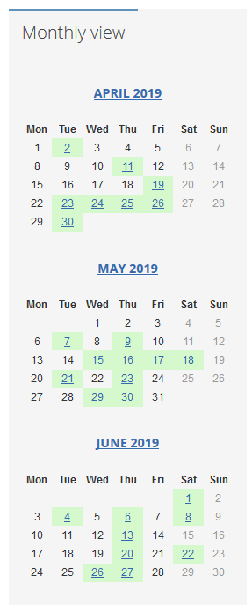
Events will be highlighted on the event calendar; personal events can also be added
Selecting this link will lead to a brochure, communication, or registration site

Slide 24
Search
The Search on home.MyODP.org searches all resources, as well as results from ASERT and AIDinPA
Notes:
One of the common requests we get is to improve the search feature. The issue with implementing this in Moodle is that not all users have access to all information on the site, and for content within course pages, the user often needs to be enrolled before it shows up in the search results

Slide 25
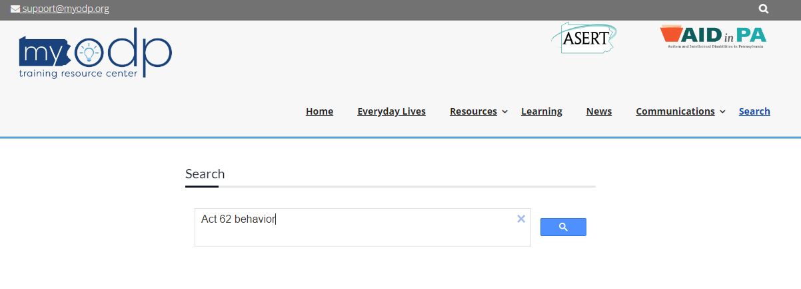
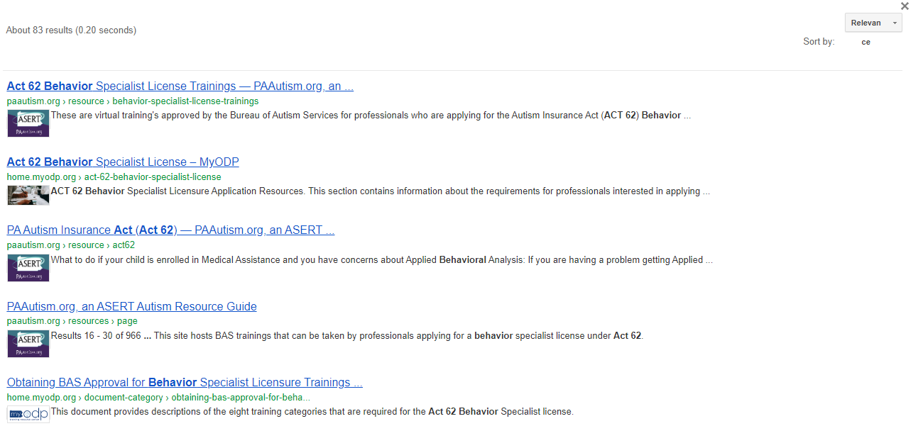

Slide 26
Learning
Clicking on Learning will ask you to login to your MyLearning page. Here you will see:
Recently accessed courses
Quick Course list – which searches names of courses
Accessibility Options
Transcripts
Certificates
MyGrades link to view current grades in the courses you have taken
MyBookings link to see any FtF sessions that you have registered for
Notes:
The Training tab will soon be labeled the Professionals tab, and will contain dropdowns of different professional roles. Each dropdown will link to a page which contains all relevant information for each professional.

Slide 27
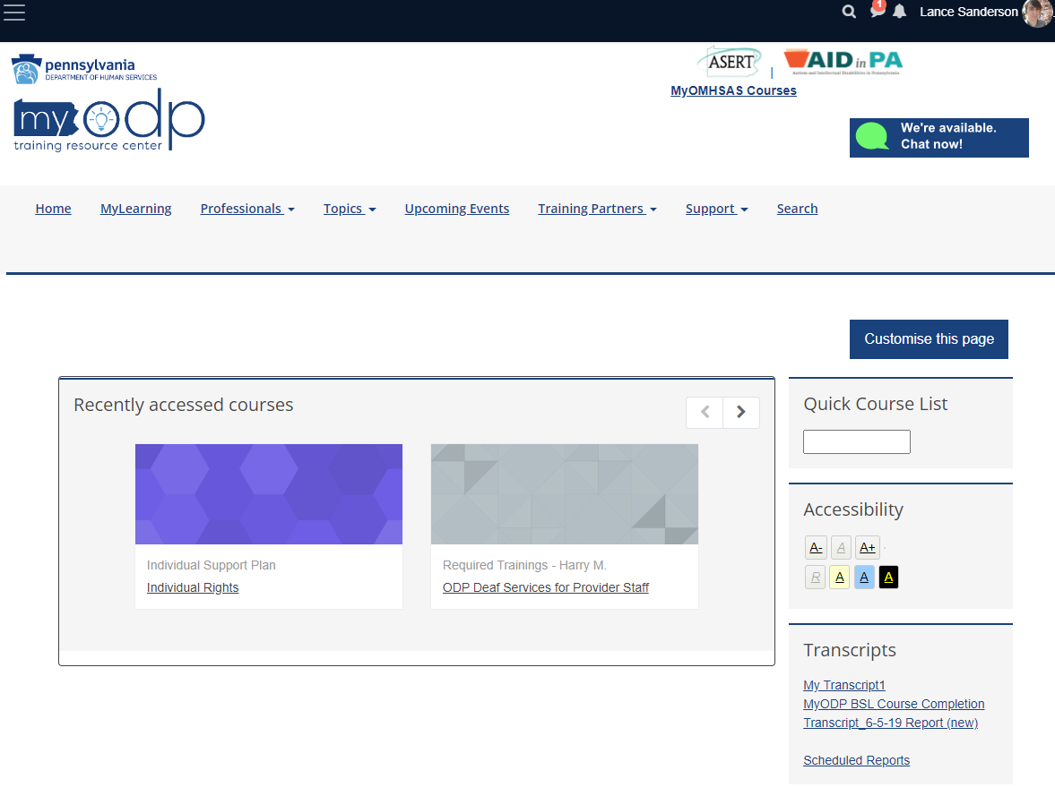
This shows recently visited courses for quick access
The quick course list searches course titles and will auto-fill with course names
Transcripts, certificates, grades, & bookings can be accessed from the sidebar

Slide 28

Professionals
Booking
Face-to-Face
H5P
Feedback
Database
Glossary
Certificate
Notes:
New Moodle versions are updated by Lambda solutions, a subcontractor to the University of Massachusetts.
We test new versions on our Staging site. The Staging site is also used to test new plugins, and develop new courses before uploading to production.
The Booking plugin is primarily used for registration for face-to-face courses. It is also used as a mechanism to auto-enroll users who complete one course into another.
We have three certificate plugins being used. “Certificate, Custom Certificate, and Simple Certificate”
- Certificate is outdated and only used in courses who made use of it before the plugin was outdated
- Custom Certificate is the replacement for “Certificate” and is used for newer courses
Simple Certificate is used for courses who require custom text on their certificate
Dataform and Face-to-Face are only used on rare occasions as core moodle plugins and the booking plugin satisfy similar functions
H5P is being used for newer courses as an alternative to webcasts and captivate/scorm modules. It allows for interactive engagement for users and on the fly editing ability for teachers.
Questionnaire is used sometimes as an alternate to the core feedback activity plugin depending on reporting needs

Slide 29
Professionals
Clicking on Learning will ask you to login to your MyLearning page. Here you will see:
Recently accessed courses
Quick Course list – which searches names of courses
Accessibility Options
Transcripts
Certificates
MyGrades link to view current grades in the courses you have taken
MyBookings link to see any FtF sessions that you have registered for
Notes:
The Training tab will soon be labeled the Professionals tab, and will contain dropdowns of different professional roles. Each dropdown will link to a page which contains all relevant information for each professional.

Slide 30
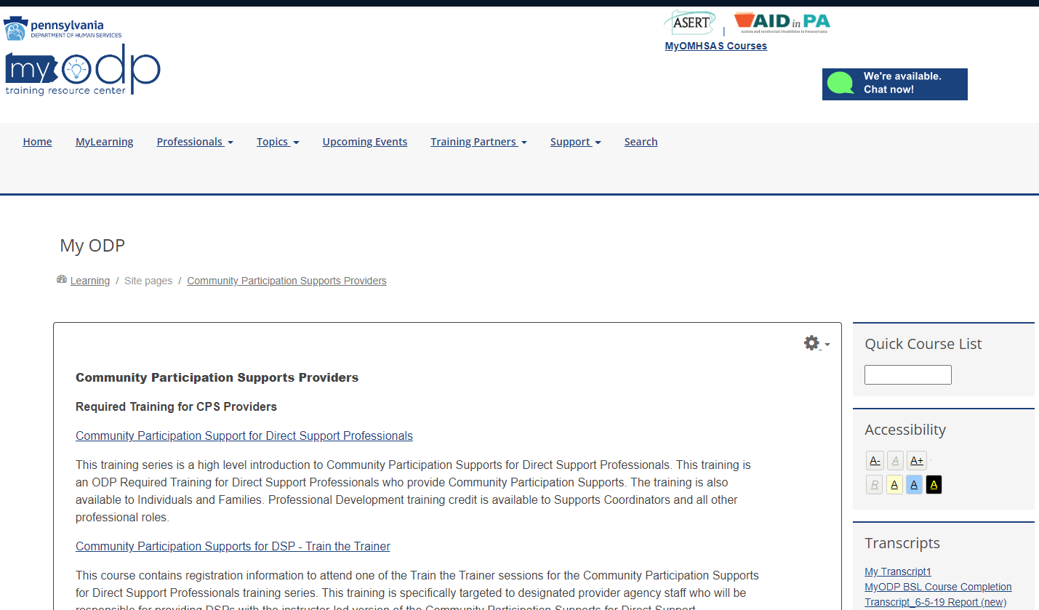
The landing pages show relevant trainings and resources to that role

Slide 31
Topics
Clicking on Learning will ask you to login to your MyLearning page. Here you will see:
Recently accessed courses
Quick Course list – which searches names of courses
Accessibility Options
Transcripts
Certificates
MyGrades link to view current grades in the courses you have taken
MyBookings link to see any FtF sessions that you have registered for
Notes:
The Training tab will soon be labeled the Professionals tab, and will contain dropdowns of different professional roles. Each dropdown will link to a page which contains all relevant information for each professional.

Slide 32
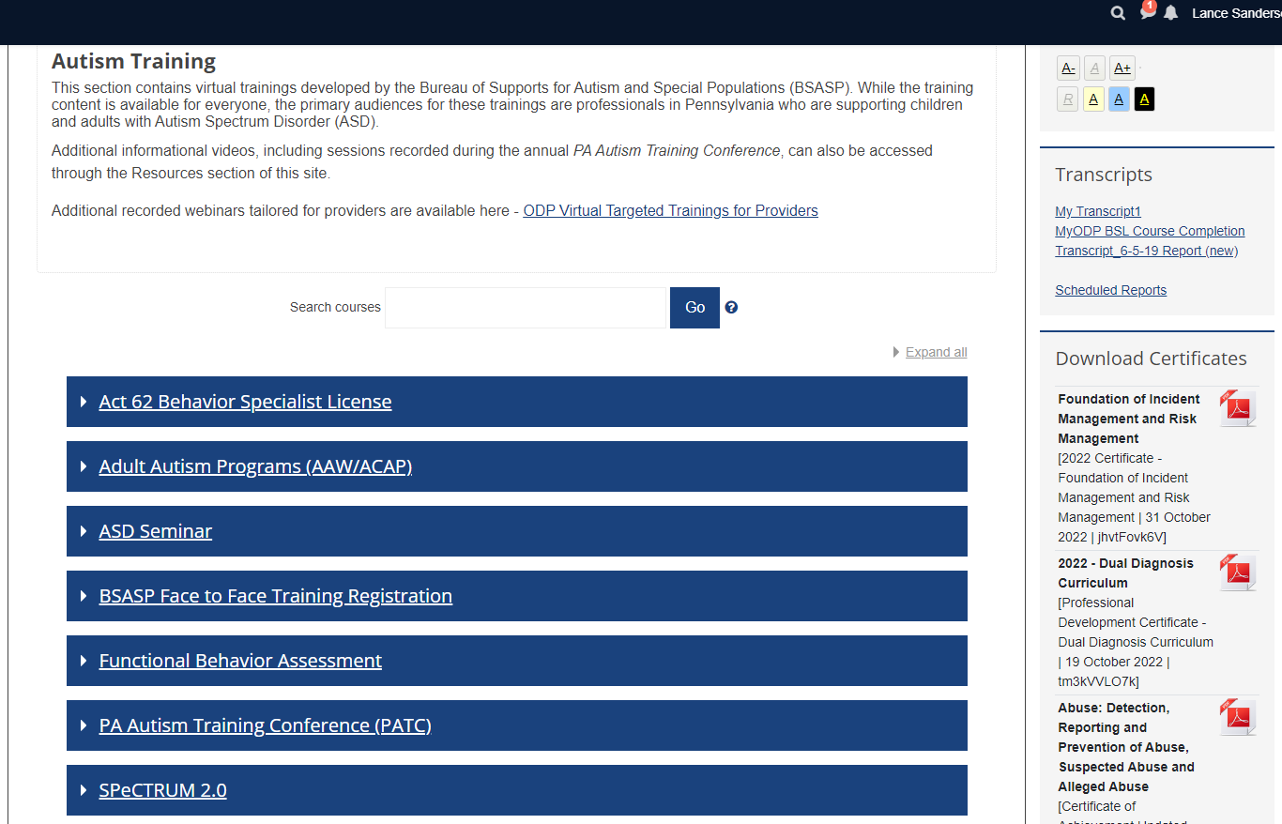
Topics show the traditional MyODP path structure with course categories displayed for each topic

Slide 33
Community Participation Supports for DSPs
This training series is a high level introduction to Community Participation Supports for Direct Support Professionals. This training is an ODP Required Training for Direct Support Professionals who provide Community Participation Supports. The training is also available to Individuals and Families.
Health, Wellness, and Safety
provides information on a variety of medical and dental care topics to support individuals with an intellectual disability to live a healthy life.
Dual Diagnosis Curriculum
The Dual Diagnosis Curriculum is part of a joint initiative of The Commonwealth of Pennsylvania, Office of Mental Health and Substance Abuse Services (OMHSAS) and the Office of Developmental Programs (ODP) to address the needs of people who have an intellectual disability as well as mental health challenges.

Slide 34
Virtual Targeted Training
This section contains supplemental Technical Assistance webinars conducted by the Bureau of Autism Services (BAS)
Special Populations – Deaf Services
Required training and targeted training related to Deaf Services. The Special Populations category will soon be expanded with Non-traditional Communication and Infographics.
Quality Management category
provides information on the Quality Management (QM) Certification Program, QM strategy and the Independent Monitoring for Quality program.

Slide 35
Training Partners
Through this tab, you can connect with ODP’s Training Partners for more resources and trainings on topics that you are looking for (transition-age resources, employment, etc.)
Our current training partners include:
The ASERT (Autism Services, Education, Resources, and Training) Resource Center
The College of Direct Support (CDS)
The Health Care Quality Units (HCQUs)

Slide 36
Support
Update MyODP Profile
the role you choose will determine which courses and content you have full access to
some roles are validated by the e-mail domain of the agency
Contact ODP
Find the ODP RA account related to your question or inquiry
Tech Support
View contact information for the Help Desk and access FAQs and Self-Help Resources
You can also view the Current Site Status if there is site-wide issues or scheduled maintenance
Notes:
The MyODP Profile is part of the “Create account process” and was custom developed and must be updated with each moodle version to ensure compatibility. Users can update this anytime through the Support menu if their roles change
Users can also contact Tech Support using a chat button in the top left corner of the site

Slide 37
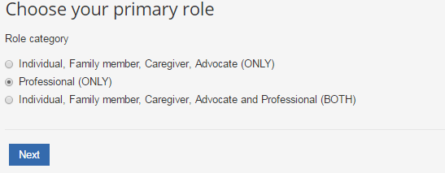
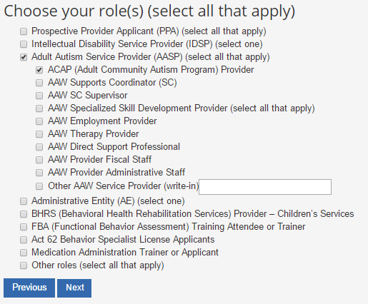
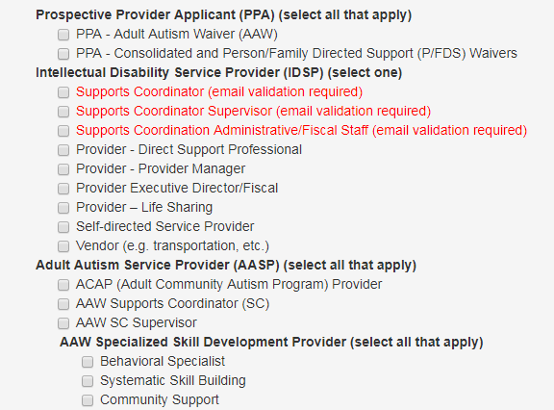
The IFCA role has similar access as a guest
Professional roles have varying access
When Choosing both, access will reflect the professional role
The role you pick will determine what trainings you have access to.
Most courses will display what roles are required to access that course.

Slide 38
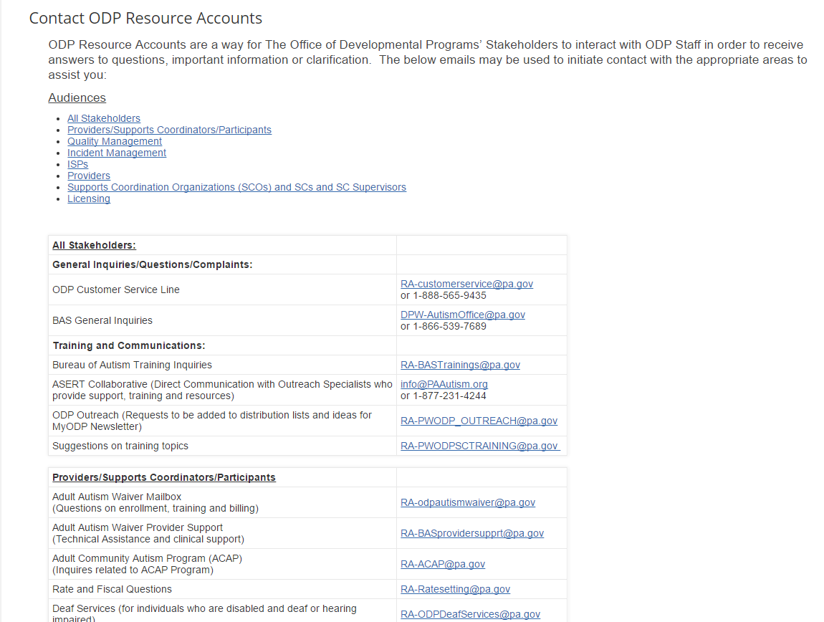
Click on an audience to filter contact information
Clicking on an address will open up a new e-mail

Slide 39
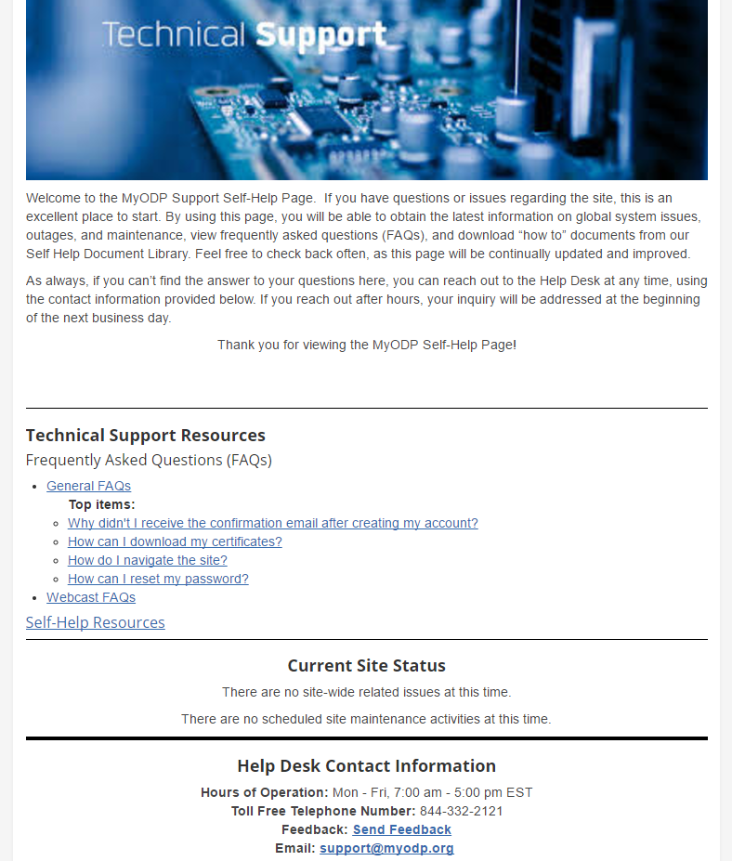
FAQs for general questions, help with video issues, and more
send feed-back on the site

Slide 40
Search
The Search feature on MyODP will search all content on the website that the user has access to, including courses and communications. Once communications are transferred, only course related results will show. For best search results, please log in.
If you search inside of a course category, it will show results based off of course titles and descriptions
Notes:
One of the common requests we get is to improve the search feature. The issue with implementing this in Moodle is that not all users have access to all information on the site, and for content within course pages, the user often needs to be enrolled before it shows up in the search results

Slide 41
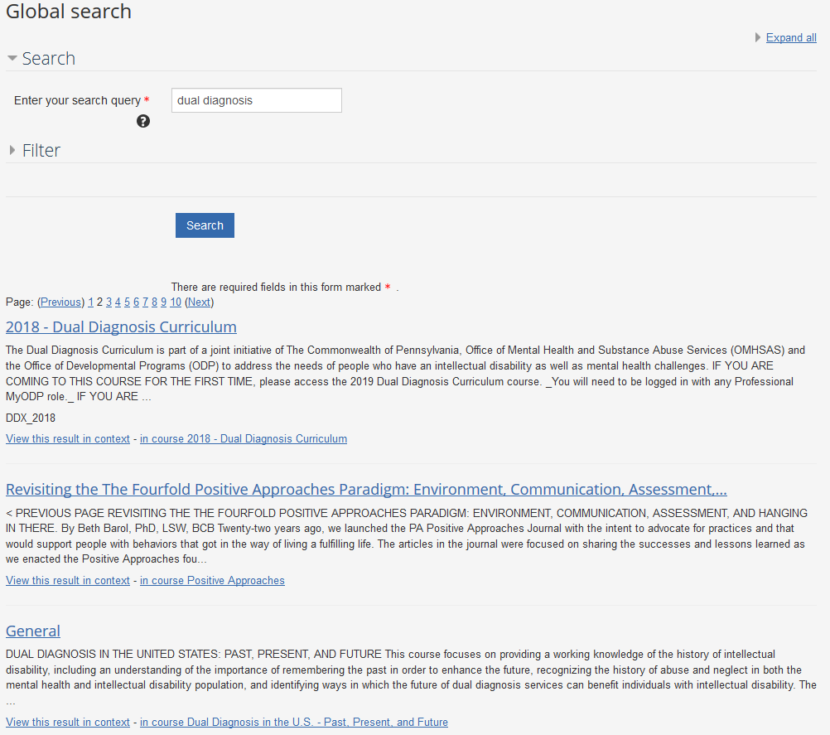
Searching with keywords will yield results in all areas on MyODP you have access to

Slide 42
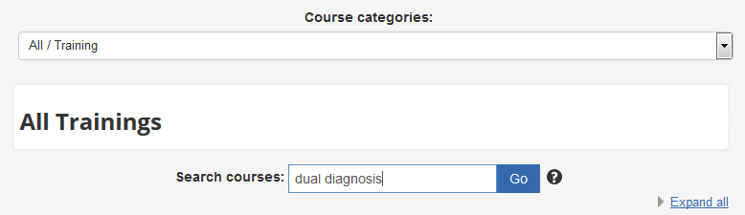

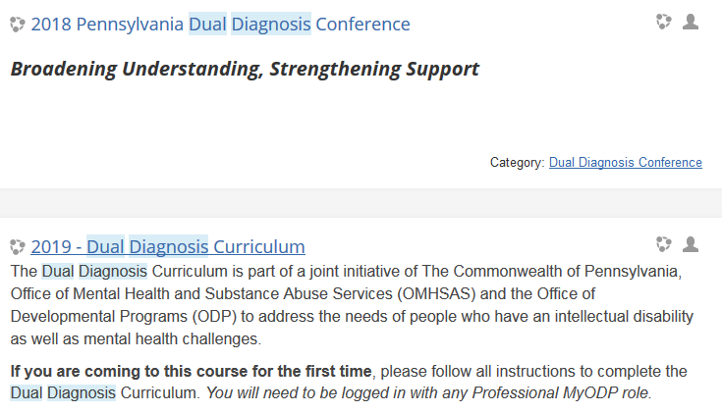
The course search will show up on any course category page
The search terms will be highlighted in the results

Slide 43
Planned Updates
Communications transferred to home.MyODP.org
Update Resource pages with unique images and file previews
Trainings will allow the user to reset the course to receive a new certificate
Professional role icons will be shown on course trainings to better indicate the audience for each course
Ensure mobile compatibility for all course activities

