Slide 1
Access for Voters with Disabilities: National Overview
Michelle Bishop
Voter Access & Engagement Manager
October 2022

Slide 2
Why Our Vote Is So Important
There are around 40 million eligible disabled voters in the US
Disability voter turnout is typically 6% behind non-disabled Americans
That’s about 3 million or so missing voters

Slide 3
Not to mention…
It’s the right thing to do.
It is federal law.

Slide 4
NDRN
National Disability Rights Network
The nonprofit membership organization for the federally mandated Protection and Advocacy (P&A) Systems for individuals with disabilities

Slide 5
The P&A Network
Established by Congress to protect the rights of people with disabilities through legal support, advocacy, referral, and education.
In all 50 states, DC, Puerto Rico, US Territories, and the Native American Consortium (Hopi, Navaho and Piute Nations in the Four Corner region of the Southwest).
Largest provider of legal advocacy services to people with disabilities in the US.

Slide 6
PAVA
Protection & Advocacy for Voter Access
Federal mandate to the P&As
Established under HAVA to “ensure the full participation in the electoral process for individuals with disabilities, including registering to vote, casting a vote, and accessing polling places.”

Slide 7
PAVA Looks Like Where You Are…
Enforcing voting rights laws
Education on changes to voting rights laws
Registering and educating voters
Working with elections administrators

Slide 8
Barriers to Watch in 2022
Challenges by poll workers/watchers
Limitations on voter assistance
Access in long term care facilities
Inaccessible vote by mail
Inaccessible polling places

Slide 9
Options for Voters in 2022
Early voting and drop box voting
Curbside voting and moving up in line
Federal right to voter assistance
Improvements to vote by mail
Making a plan to vote, addressing accessibility in advance

Slide 10
Guardianship & Voting
Laws are different in every state
PA: You can vote under guardianship
State laws and other resources:
It’s Your Right. A Know-Your-Rights Guide for Voters with Mental Disabilities and Advocates
Voting Accommodations for People with Mental Disabilities

Slide 11
Some Resources for Voters
Stress contacting local elections officials
Poll Watchers & Challenging Voter Eligibility
FACT SHEET: Voter Challenges at the Polls
Know the difference between poll watching and voter intimidation
Check your registration, polling place, and ballot
Vote411

Slide 12
Election Protection Voter Hotlines
1-866-OUR-VOTE English
1-888-VE-Y-VOTA Spanish & English
1-888-API-VOTE Asian Languages & English
844-YALLA-US Arabic & English

Slide 13
Additional Voter Hotlines
1-866-687-8683 Text Election Protection
866ourvote.org
Chat with Election Protection
1-301-818-VOTE ASL Voter Hotline by the National Association of the Deaf

Slide 14
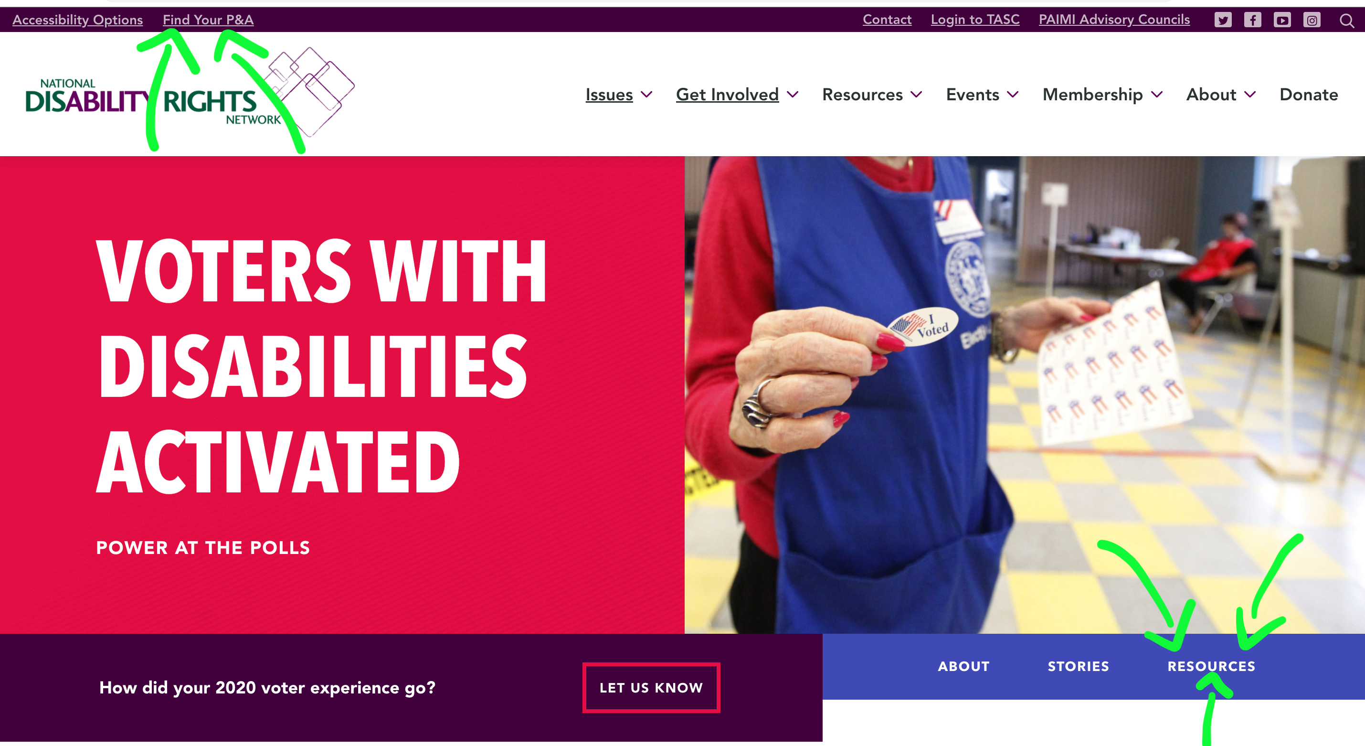
Find Us!
www.DisabilityRightsPA.org
www.VotersWithDisabilities.org
www.NDRN.org

Slide 15
National Disability Rights Network
820 First Street NE, Suite 740 Washington, DC 20002 P: 202-408-9514 ◊ TTY: 202-408-9521 www.ndrn.org

